Slide 1
Learning LOG or What have we learned that we want to share?

Slide 2
Introduction
The Municipality of AVV is a county with markedly rural characteristics, but it presents an urban nucleus with characteristics of a city.
For this reason, there is a concentration of population in the urban area and consequently the desertification of rural areas, strongly motivated by the strong emigration that has always occurred in the County.
This situation leads to social problems related to the aging of the population and to the isolation of older populations, which is why it is one of the areas of action of the Municipality, that is, in the fight against isolation.
Alongside this social context, the municipality is served by a wide range of public and private entities that offer a set of responses and services to the most vulnerable groups (nursing homes, home support services, day care centres, kindergartens, among others).
Increasingly, social support entities have been demonstrating the need for a municipal entity to regulate and coordinate the voluntary work that they develop.
Increasingly, social support entities manifest a need in the existence of a municipal entity that regulates and coordinates the volunteer work that they develop.
Historically, there has been a tradition of mutual assistance among the population, which has since been lost due to the social changes underlying development and industrialization, but which would be extremely useful to revive.
It is taking in these two contexts that our plan intends to leverage municipal volunteering, that is, to take the current experience of volunteer work developed by the IPSS and transpose it to the Arcuense community of involving it in actions that arouse volunteer work.
We will have as main barriers the fact that we are in a desertified and aged territory, where the recruitment of young people for volunteering becomes difficult, as well as the weak civic participation of the population in general and the youth in particular.

Slide 3
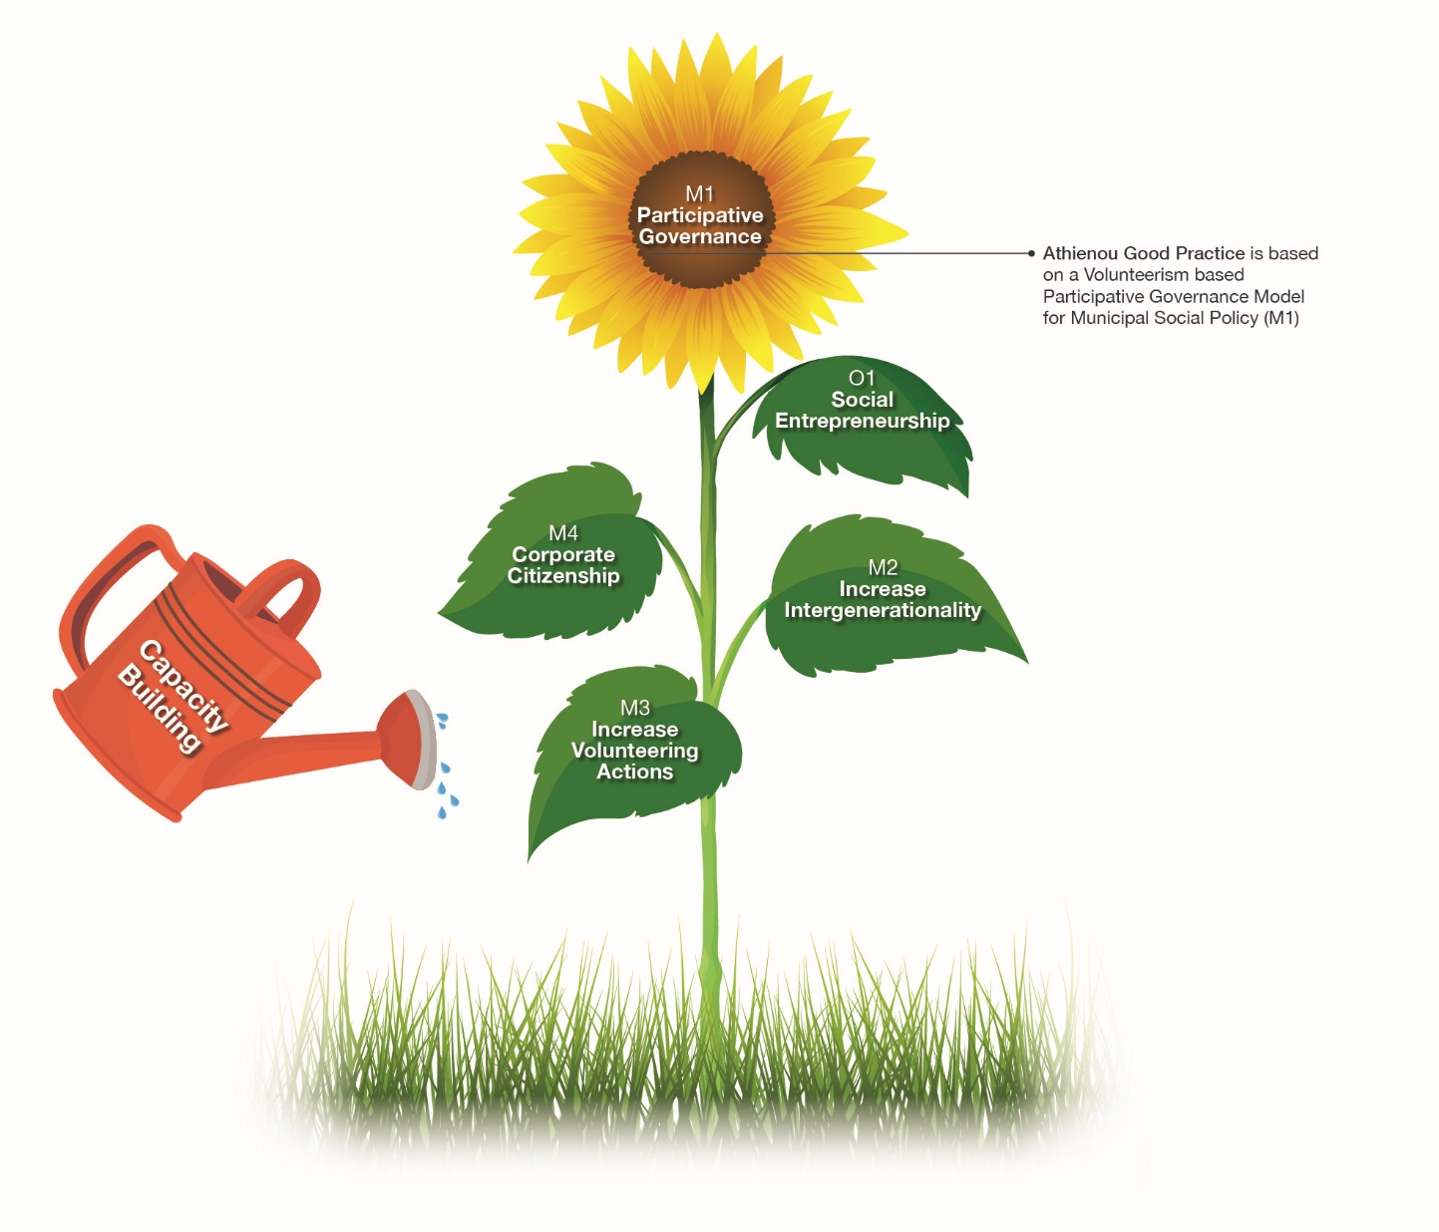

Slide 5
We have achieved the objectives of our TPs?
WHAT HAS CHANGED?
TRANSFER
GUIDE
Individuals
Organisations
Community
Sharing our Learning and Experiences with other cities

Slide 6
Arcos de Valdevez
M1 Participative Governance
 | 1ST JANUARY 2019 | 20th JANUARY 2020
INDIVIDUALS | Most of the actions carried out were done in an individual manner, with little involvement between the various partners. People's unwillingness to help globally, they only do so when specifically called for a moment. | STRENGTHENED: Increase in the number of people enrolled in the volunteer bank to provide services in various areas.
ORGANISATIONS | - We only had CLAS, which made a small allusion to volunteering. | INNOVATION: There is a great involvement of the City Council and all partners in the organization, in the dissemination and execution of projects and actions through MCV.
COMMUNITY | - Low adherence and disorganization of volunteers in groups, and their distribution among entities. | STRENGTHENED: community organized around the social problems created by the pandemic.
Key Learnings:
The coordinators and members of the ULG are in agreement that, with working together, it was much easier to organize the various actions and day-to-day activities of the institutions.
Volunteers felt more motivated to enroll in the volunteer bank when they saw the good work done over these months.
Emilia Cerdeira in Altea’s TNM we can once again see that this group is more and more cohesive and strong. we can define, with the help of our partners, a line of thought and a chronological line for the development of this process. it was important to also see that, not only if one works very well in this group, but one can also have a good free time to enjoy the city so well received. Once again, although culturally different, we can see that the objectives are common to all countries, political, technical and social objectives. We came from an open mind, but above all concrete ideas to achieve a greater and better development for our territory.

Slide 7
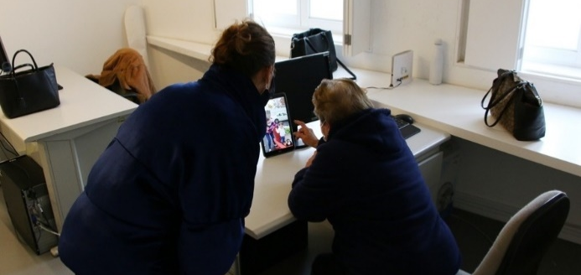
Arcos de Valdevez
M2 Intergeracionality
 | 1ST JANUARY 2019 | 20th JANUARY 2020
INDIVIDUALS | - Young people little involved in volunteering, especially with the elderly. | STRENGTHENED: Various sports activities carried out by young people for the elderly.
ORGANISATIONS | - Few actions, in schools, homes or associations, involving young and old. | INNOVATION: various actions by schools and youth associations to help the elderly in their daily lives.
COMMUNITY | - Volunteering seen as work of the unemployed or retired. | STRENGTHENED: Several animation or communication actions were carried out, taken by the youngest to the elderly.
Key Learnings:
https://www.cmav.pt/pages/1848?news_id=4781
In the context of the pandemic, young volunteers visit the most isolated elderly and make video calls to families with them. For example, on November 13, "D. Maria" said that she would be able to sleep better after seeing that her children were healthy.
* the two activities organized by young people for the elderly (Olympics and Senior Festival) had to be canceled because of COVID-19, and are expected to be held in 2021

Slide 8
Arcos de Valdevez
M3 Young volunteers
 | 1ST JANUARY 2019 | 20th JANUARY 2020
INDIVIDUALS | - Young people's ignorance of what they can do to help the community | STRENGTHENED: most of the registered volunteers are under 35 years old.
ORGANISATIONS | - Do not deal well with the reception of young volunteers in different institutions. | INNOVATION: great involvement of young people in the environmental vacation program for young people.
COMMUNITY | - Young people seen as inexperienced and unmotivated. | STRENGTHENED: People, seeing the good work done by the local youth, end up receiving them better and follow their example.
Key Learnings:
Diana Cerqueira in Arcos’s TNM “this meeting we counted with the presence of the partners, representatives of the cities, members of ULG’s and some volunteers.
To opening the meeting we have the pleasure to listen the welcome from the hosting mayor and also from the lead partner.
We took some time to learn about each other building histories together and finding interesting characteristics of each other. This dynamic permitted the new ones in the process to understand a little bit better the groups and its profile. For me as a member of a Youth Association that works a lot with Non Formal Education was a pleasure to see this activity happening.
After some laughs together we had the chance to listen and learn from an introduction to the programme and start to work in the Transferability Plans. We also revised the methodology to be used.
During this two days in Arcos de Valdevez the partners add also the chance to visit 2 very different projects in Arcos de Valdevez.
Incubo is a enterprises incubator and is mainly used by young enterprises that need a support in their beginning. The incubator is very connect to the topic of entrepreneurship that they use to most of theirs activities and actions in the local community. Several of them have also their headquarters in the building of the incubator. Besides Incubo also as a FabLab that can be used by local entrepreneurs and local organizations/enterprises to make prototypes and different kind of works.
Associação Social Recreativa Juventude de Vila Fonche/Juventude is a youth association that works in the social field and as a clear target in the work with children and young people. This organization as a kindergarten and a Free Times Activities Centre, Pousadinha (small “hostel”), develops activities to the community and as a great focus on the mobility programs to young people trough Erasmus+ and other national/international programmes.
After the visits that allow the participants to have a more clear idea about the reality of Arcos de Valdevez, it was time to return to the work and focus on more organizational parts of the project and also to proceed with clarifications about the way things should be done and communicated, spread among partners and in the local communities, and also about dates, budget and all the logistical information/clarification that was necessary.
This meeting setup strong bases of work that I’m pretty sure will make this a really successful project in each all the partners can be really and actively involved and, above all, that the local communities will be able to benefit from in the form of volunteer activities and capacitation to action.

Slide 9
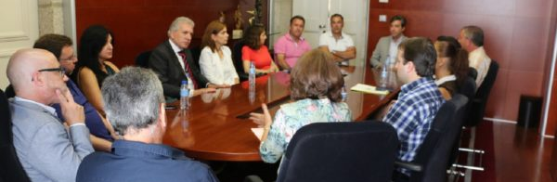
Arcos de Valdevez
M4 Corporate Social Responsibility
 | 1ST JANUARY 2019 | 20th JANUARY 2020
ORGANISATIONS | - The voluntary actions worked with private and individual funds. | INNOVATION: Small and medium-sized companies were involved in volunteering and supporting people and families who were victims of the pandemic, associating themselves with the efforts and projects of the Municipality and the MCV.
Key Learnings:
A group of companies purchased second-hand beds in Germany and offered to the elderly hosees to help renovate the furniture in these institutions.

Slide 10
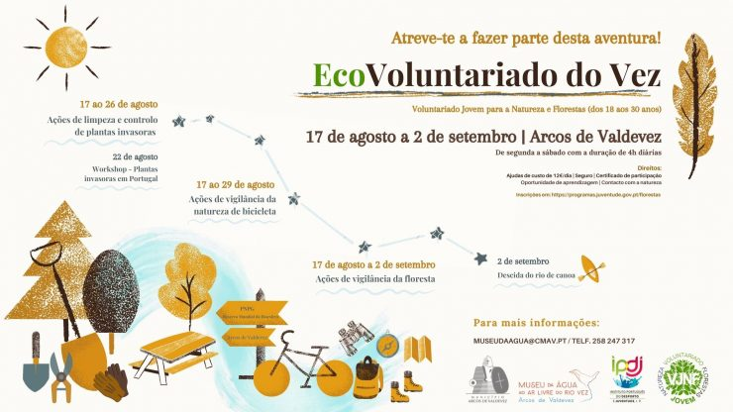
Arcos de Valdevez
O1 Increase Volunteering Activities
 | 1ST JANUARY 2019 | 20th JANUARY 2020
COMMUNITY | - Social support entities manifest a need in the existence of a municipal entity that regulates and coordinates the volunteer work that they develop | STRENGTHENED: Organization of three campaigns to raise volunteers and social activity by digital means.
Key Learnings:
Campains done in Arcos and Vox Pops

Slide 11
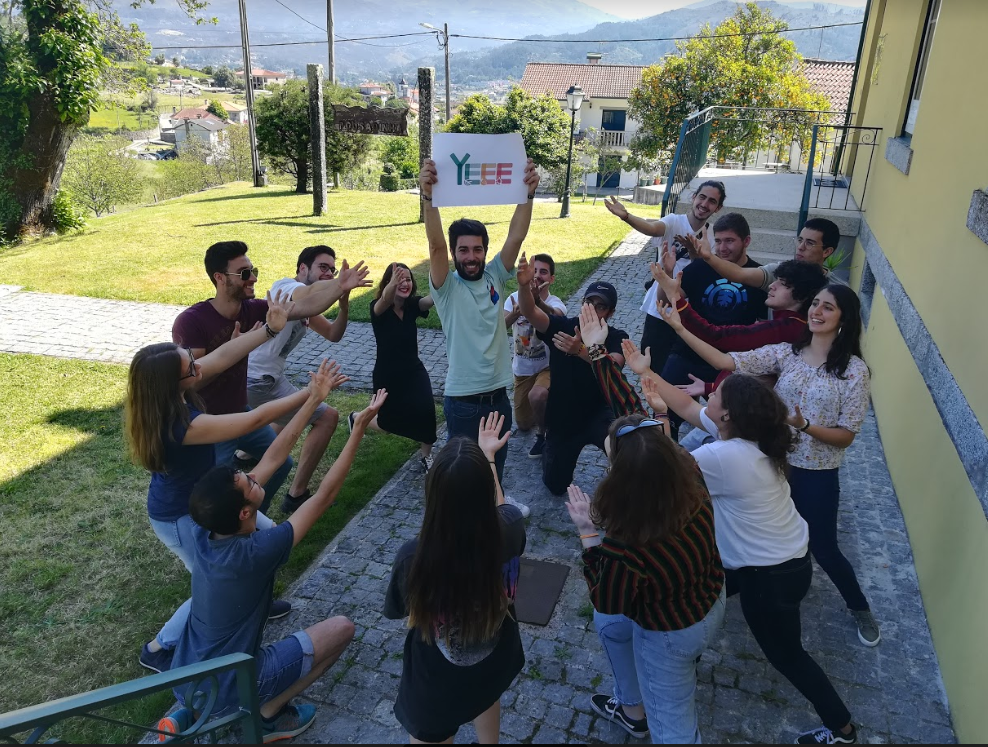
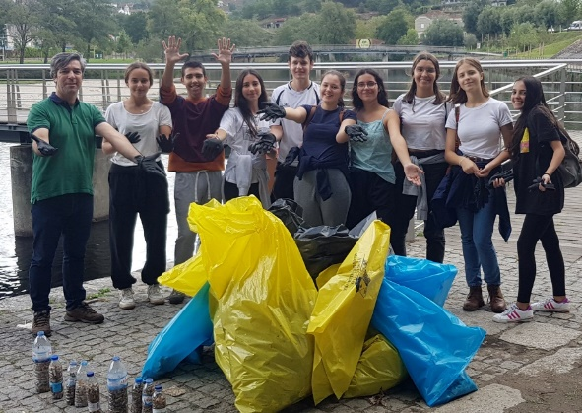
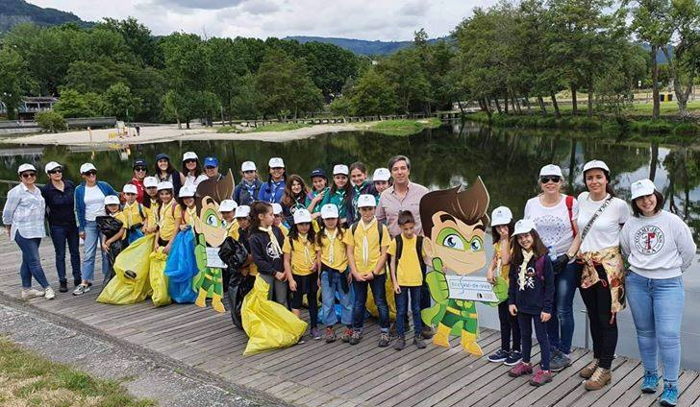
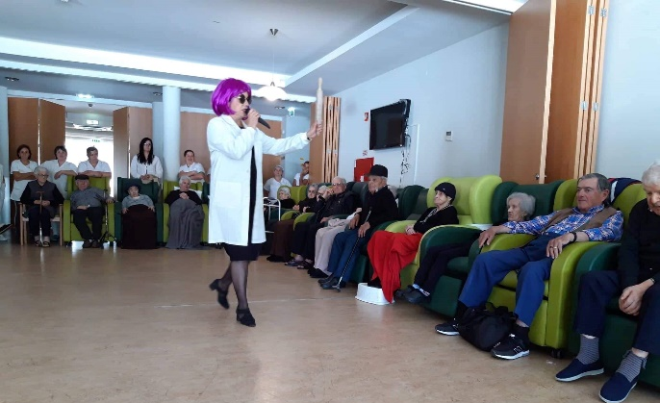
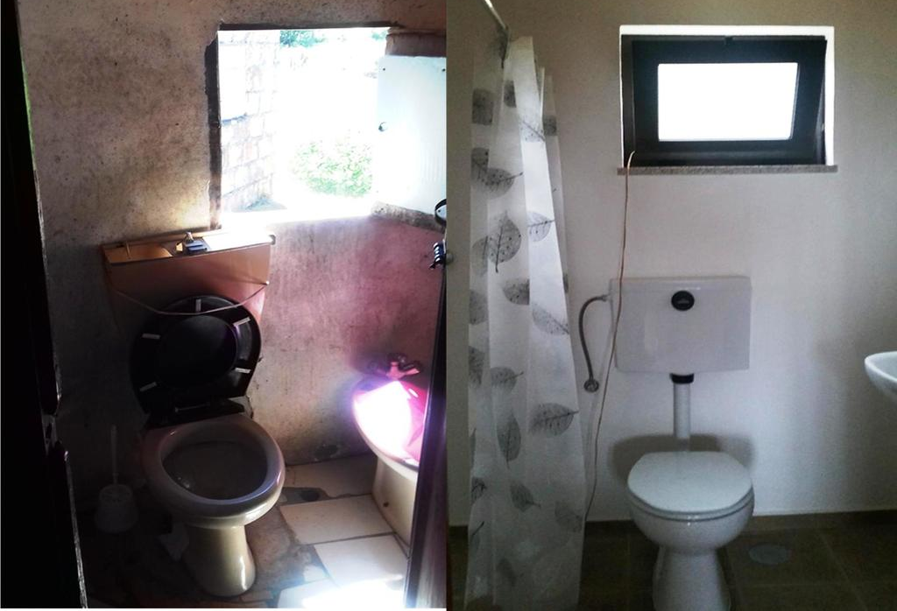
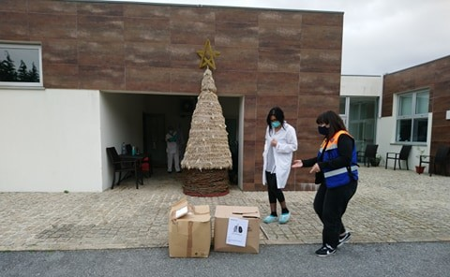
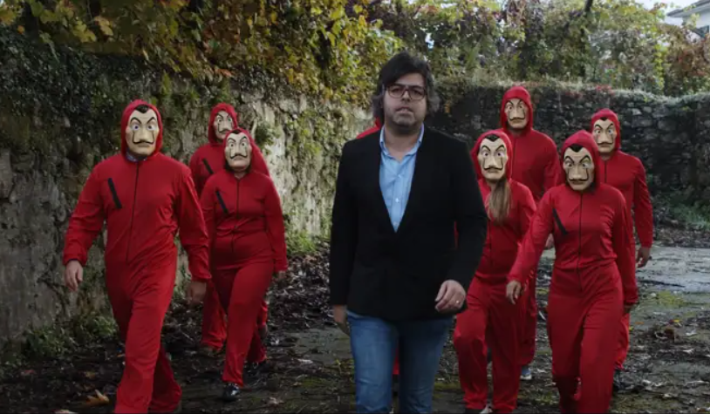
Images speak by themselves...

