Slide 1


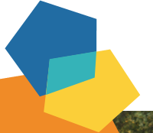
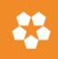

Volunteering Cities
Learning Log

Slide 2
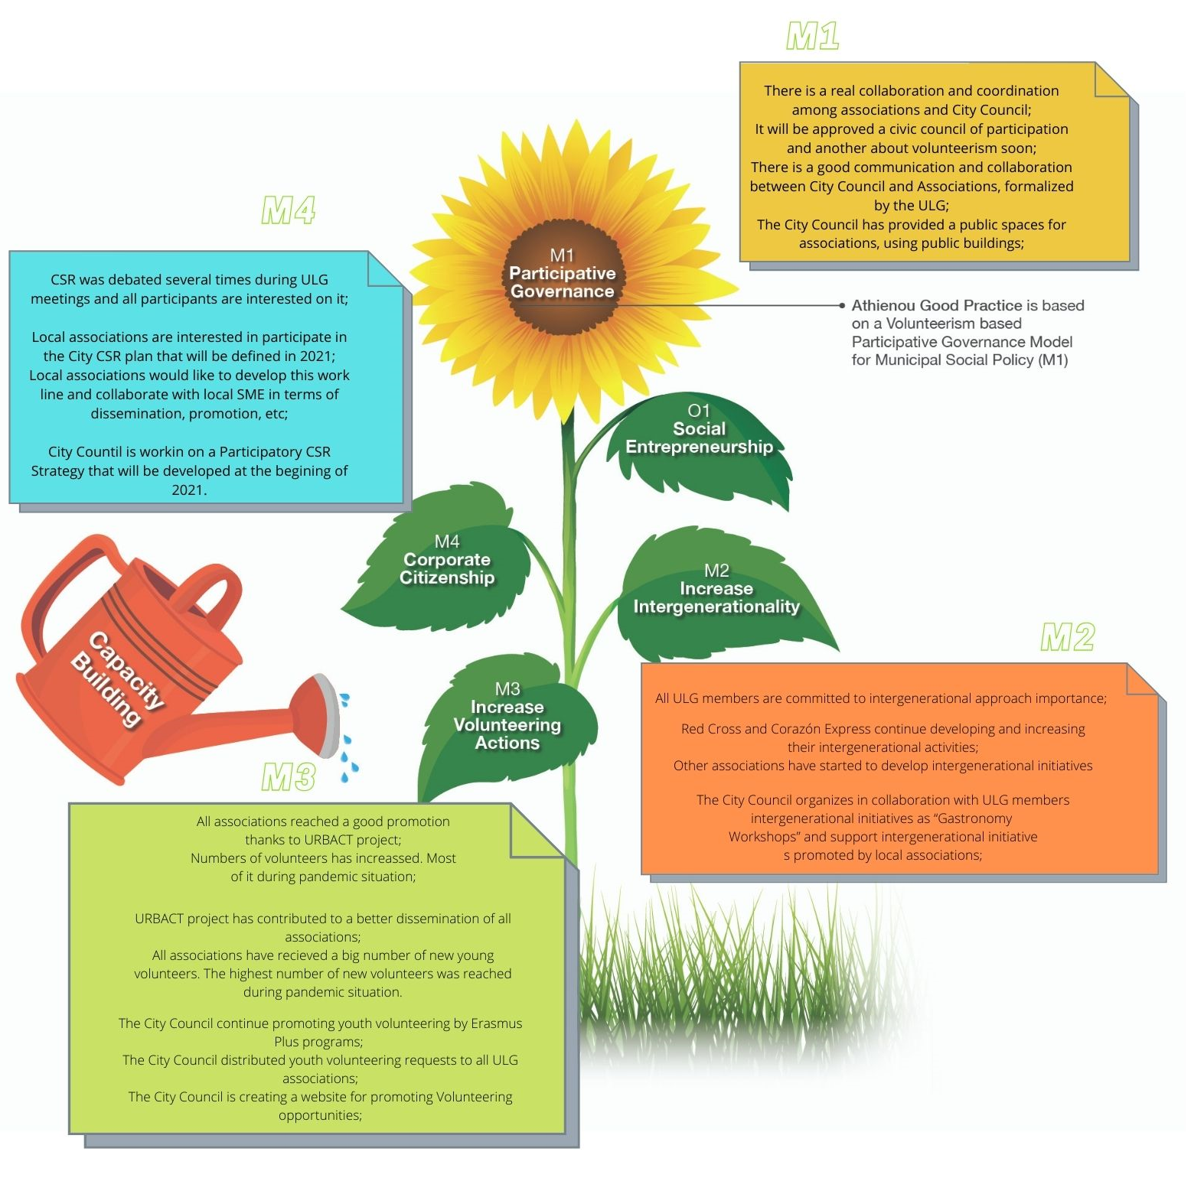


Transfer Networks_Towards Phase 2
Notes:
Your customised menu
2

Slide 3
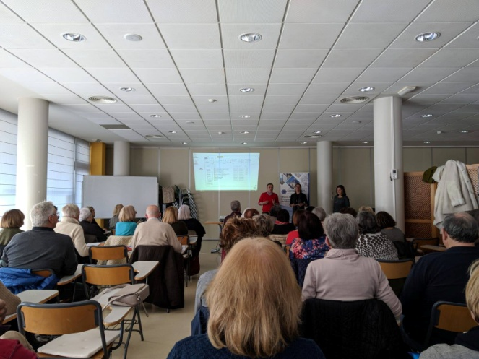
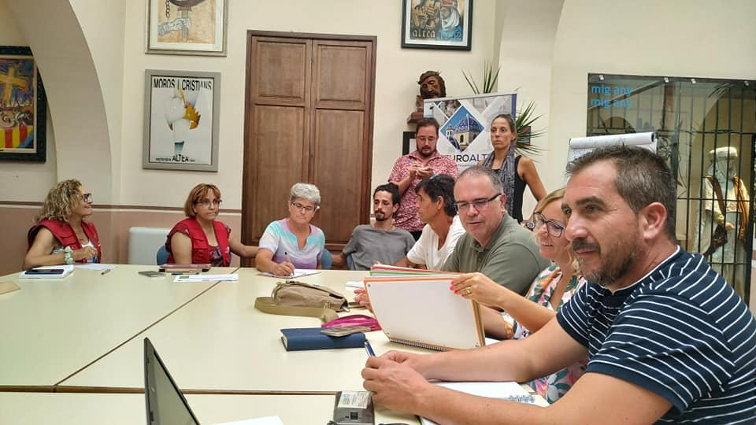
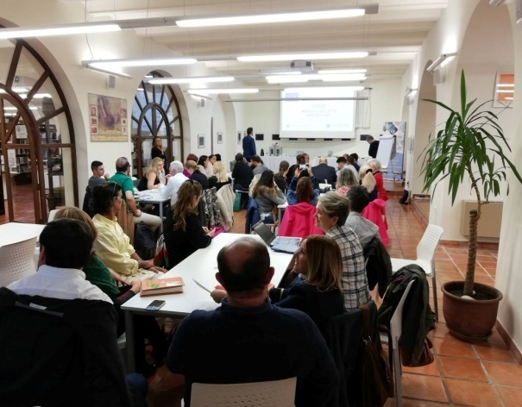
MODULE 1
PARTICIPATIVE GOVERNANCE
Towards the Sharing Period…
What has changed?
 | 1st January 2019
Individuals | They are very focused on its specific and individual activities and projects;
Organisations | There are several local associations but there is not relevant collaboration between them; There are not a good communication and they don’t really know each other works;
City | It is opened to collaborate with local associations; There is not a local civic council of participation and neither about volunteerism; Collaboration between City Council and Associations are not well estructured;
Transfer Networks_Towards Phase 2
Notes:
Your customised menu
3

Slide 4
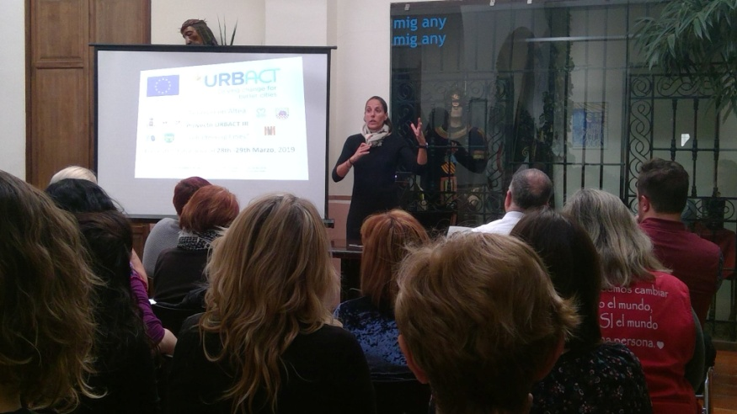
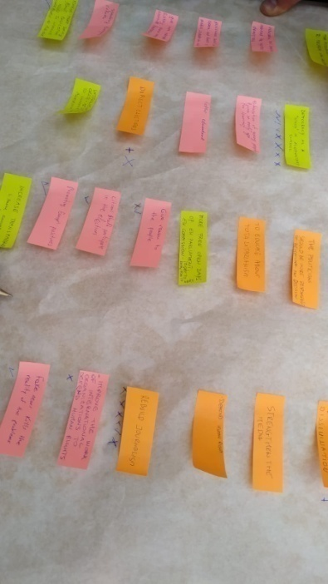
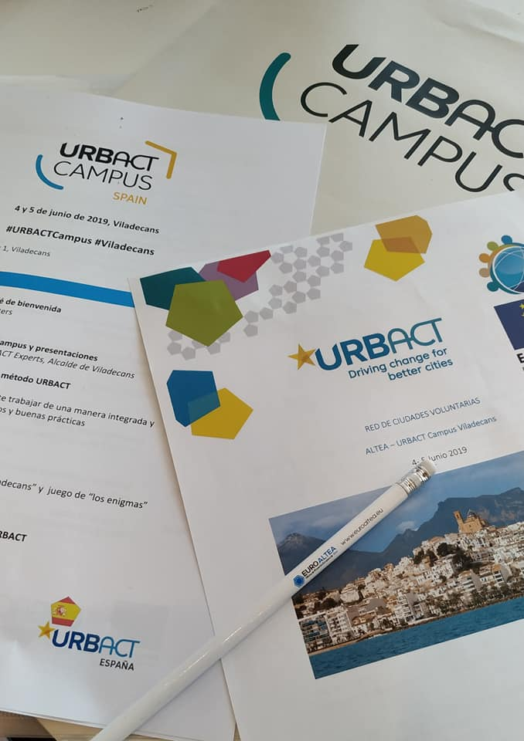
MODULE 1
PARTICIPATIVE GOVERNANCE
Towards the Sharing Period…
What has changed?
 | 31st December 2020
Individuals | They have opened their focus to new work fields and new initiatives; They are opened to collaborate and establish synergies;
Organisations | There is a real collaboration and communication between associations that demostrated during COVID19 pandemic; They know each other, they have a good communication and they create synergies between them; Municipal spaces have been shared with associations
City | There is a real collaboration and coordination among associations and City Council; It will be approved a civic council of participation and another about volunteerism soon; There is a good communication and collaboration between City Council and Associations, formalized by the ULG; The City Council has provided a public spaces for associations, using public buildings;
Transfer Networks_Towards Phase 2
Notes:
Your customised menu
4

Slide 5
MODULE 1
PARTICIPATIVE GOVERNANCE
Towards the Sharing Period…
Change/Transfer Process Key Learnings
1.Individuals | 1.1. Committment of the European Projects and Civic Participation Councelor and its technicians; 1.2. Committment of the Social Affairs Councerlor and its technicians; 1.3. Committment of the Youth Councelor and its technicians; 1.4. Committment of all key players of all local associations to participate in the project; 1.5. Motivation about learning and improve of all ULG members;
2.Organisations | 2.1. Committment of all local associations members of the ULG was determinant for the success; 2.2. Good communication and motivation to collaborate and develop synergies; 2.3. Motivation about learning and improve from other associations and experiences;
3.City | 3.1. Committment of the Local Government was determinant for the success; 3.2. Committment of the local staff was determinant for the success; 3.3. Public staff and local government invested efforts to guarantee a proper development of this module 1; 3.4. URBACT learnings, study visits, etc. have motivated staff members; 3.5. Importance of counting on a civic structure (ULG – Volunteering Council);
Transfer Networks_Towards Phase 2
Notes:
Your customised menu
5

Slide 6
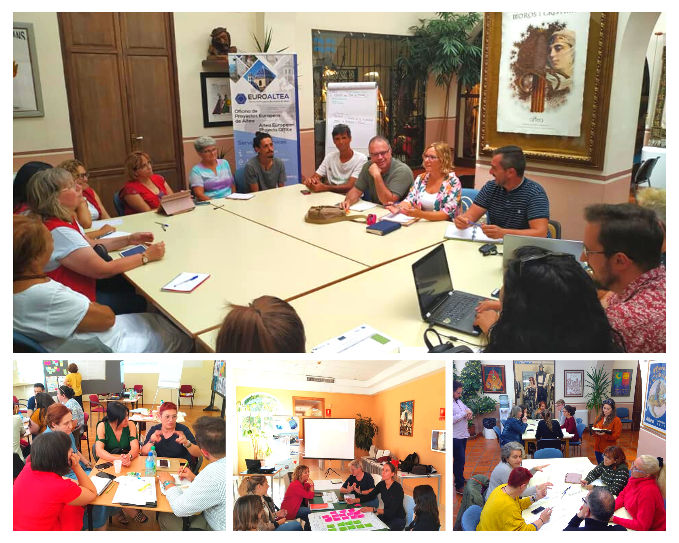

Slide 7
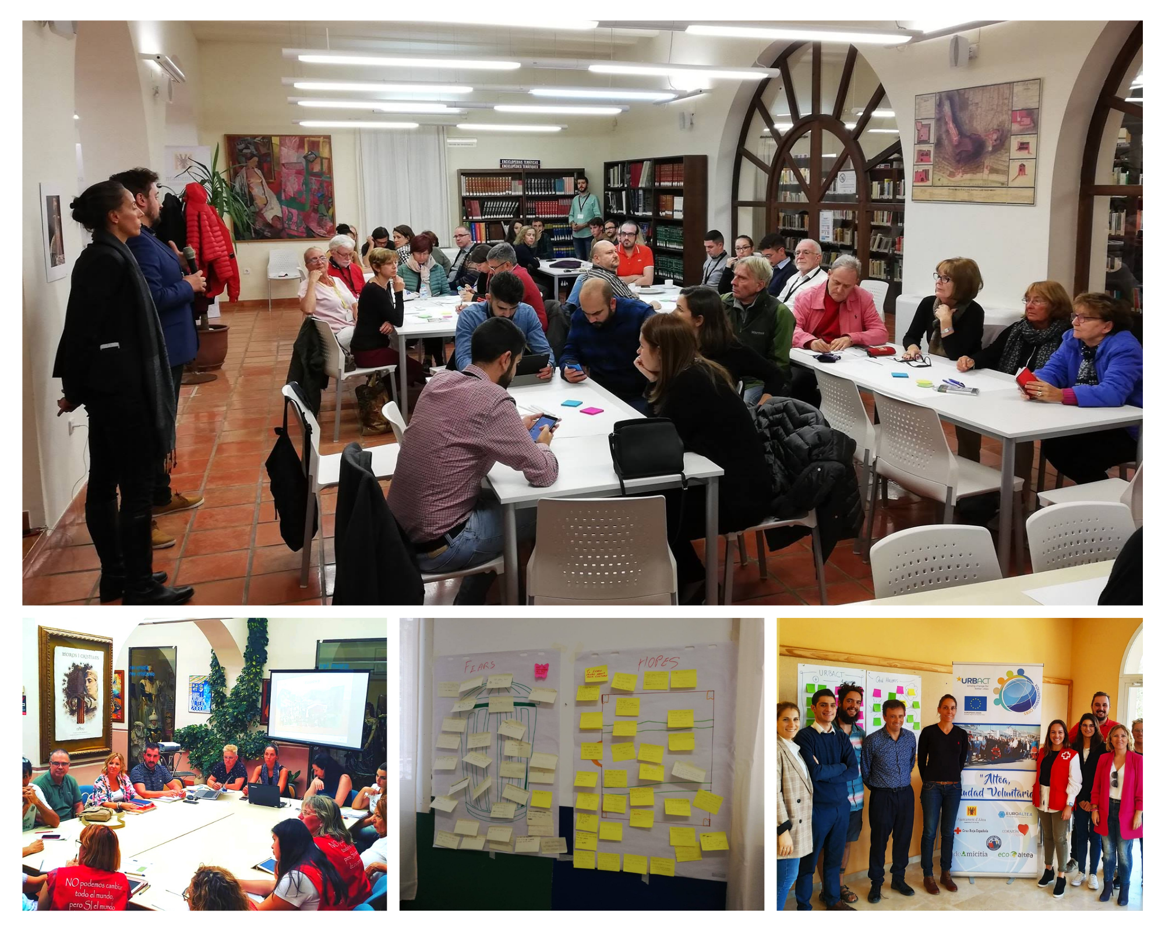

Slide 8
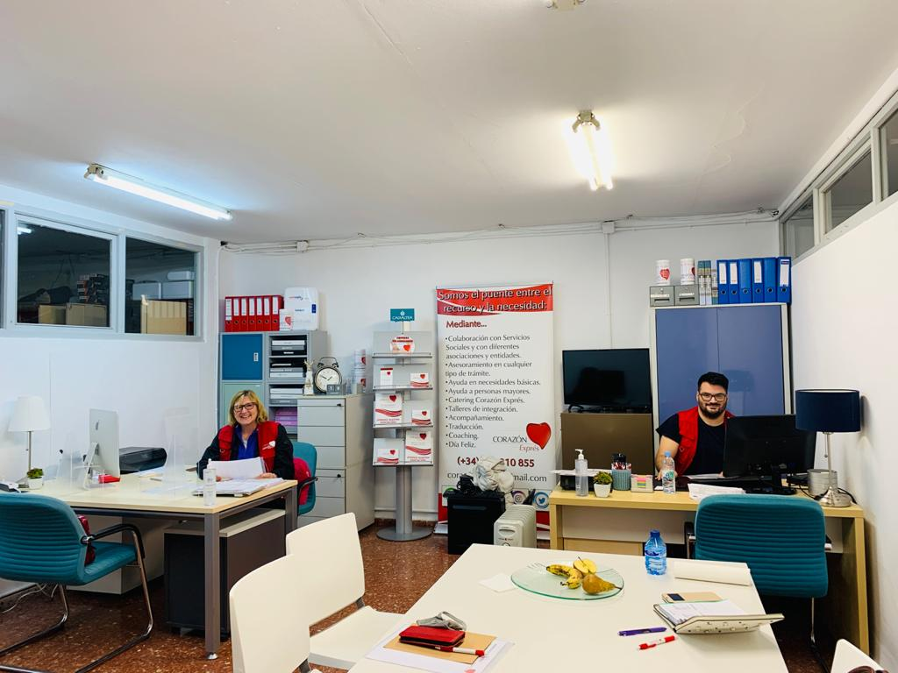
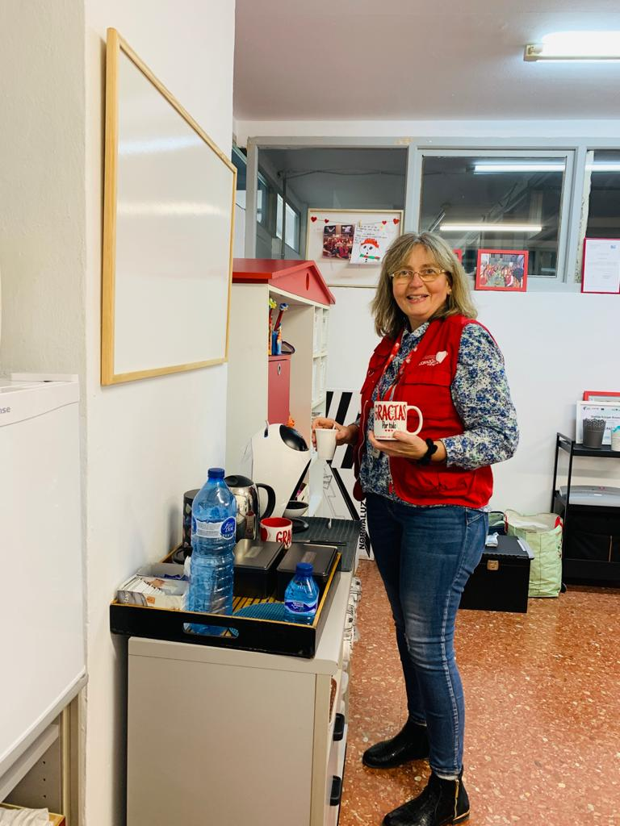
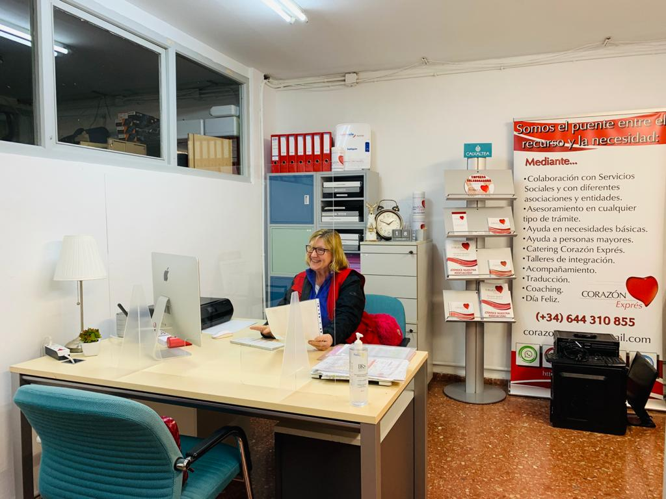
Collaboration: sharing of local government office space

Slide 9
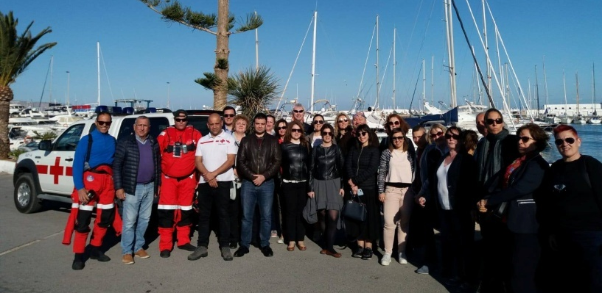
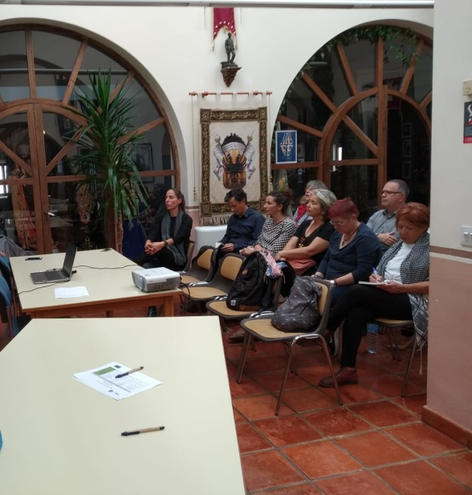
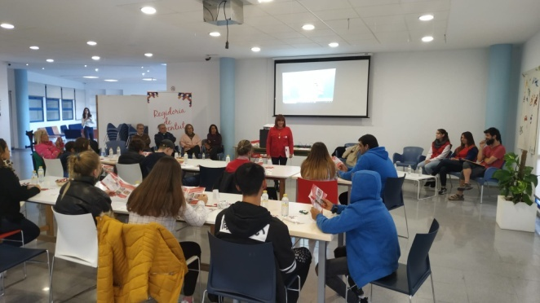
MODULE 2
INTERGENERATIONALITY
Towards the Sharing Period…
What has changed?
 | 1st January 2019
Individuals | Some ULG members don’t work on the field of intergenerationality;
Organisations | Red Cross counts on significant initiatives using intergenerational approach; Corazón Express counts on significant volunteering projects to support elderly people;
City | Social Services works on support elderly people;
Transfer Networks_Towards Phase 2
Notes:
Your customised menu
9

Slide 10
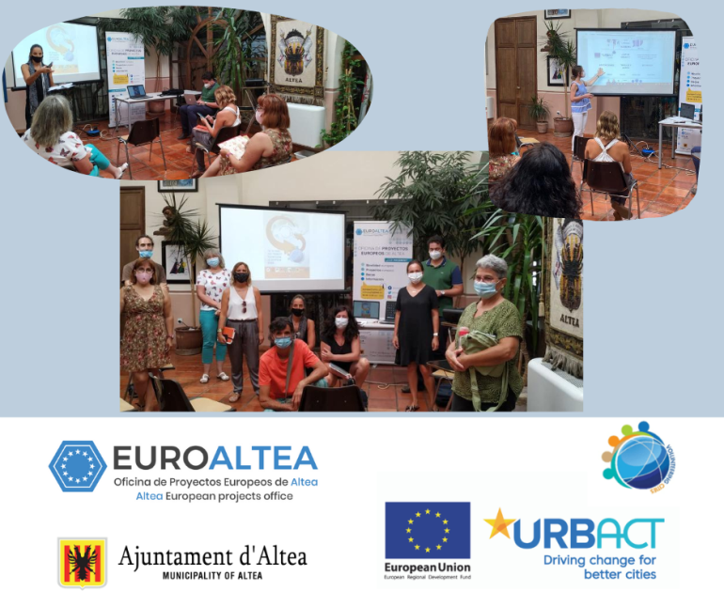
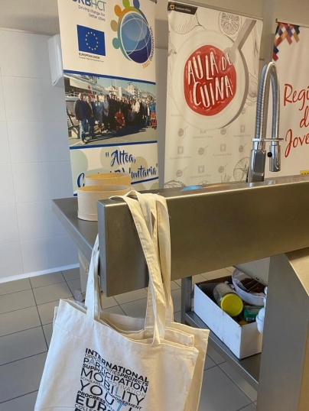
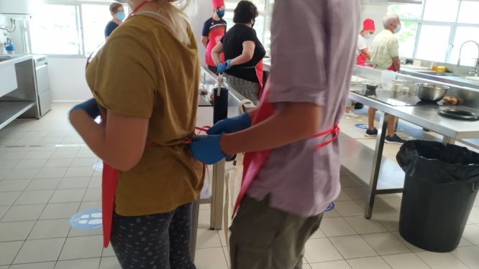
MODULE 2
INTERGENERATIONALITY
Towards the Sharing Period…
What has changed?
 | 31st December 2020
Individuals | All ULG members are committed to intergenerational approach importance;
Organisations | Red Cross and Corazón Express continue developing and increasing their intergenerational activities; Other associations have started to develop intergenerational initiatives;
City | The City Council organizes in collaboration with ULG members intergenerational initiatives as “Gastronomy Workshops” and support intergenerational initiatives promoted by local associations;
Transfer Networks_Towards Phase 2
Notes:
Your customised menu
10

Slide 11
MODULE 2
INTERGENERATIONALITY
Please use all the evidence materials relating them to each point (diaries, Vox-pops, videos, photos, etc)
Key Learnings
1.Individuals | 1.1. Increasing awareness and committment from Councelors and Technicians; 1.2. Increasing awareness and committment of the Social Affairs Councerlor and its technicians; 1.3. Increasing awareness and committment of the Youth Councelor and its technicians; 1.4. Increasing awareness and committment of all key players of all local associations to work on intergenerationality approach; 1.5. Motivation about organize and implement more intergenerational initiatives;
2.Organisations | 2.1. Increasing awareness and committment of all local associations members of the ULG about how important is intergenerationality for social volunteering projects; 2.2. Good communication and motivation to collaborate and develop synergies between associations and involved organizations; 2.3. Motivation about learning and improve from other associations and experiences;
3.City | 3.1. Committment and support of the Local Government was very important for the success; 3.2. Committment and support of the local staff was determinant for the success; 3.3. Public staff and local government invested efforts to guarantee a proper development of this module 2; 3.4. URBACT learnings, study visits, etc. have motivated staff members; 3.5. Importance of counting on a civic structure (ULG – Volunteering Council);
Transfer Networks_Towards Phase 2
Notes:
Your customised menu
11

Slide 12


Slide 13
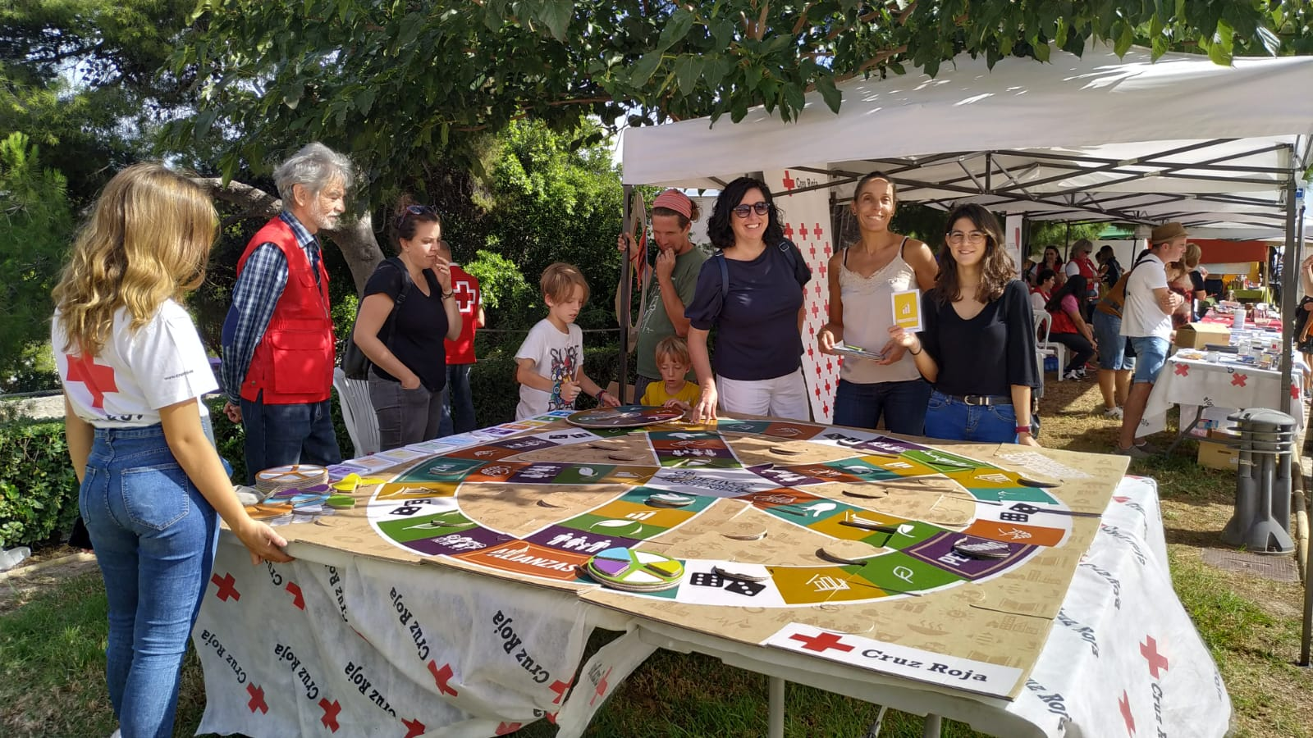
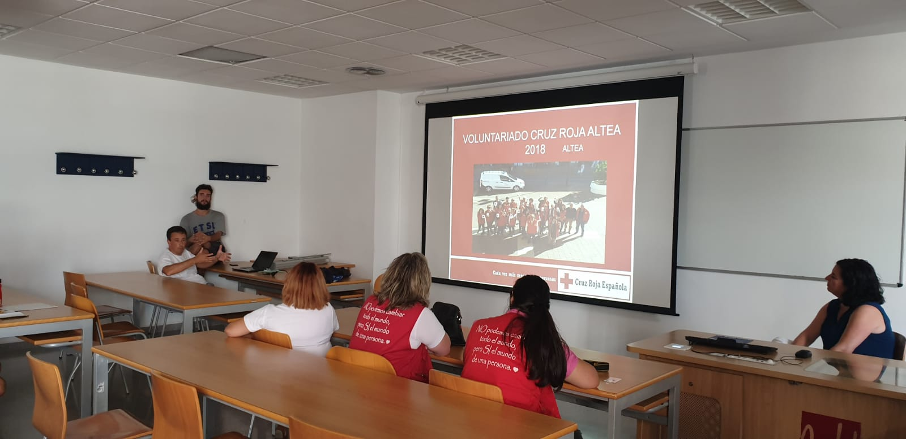
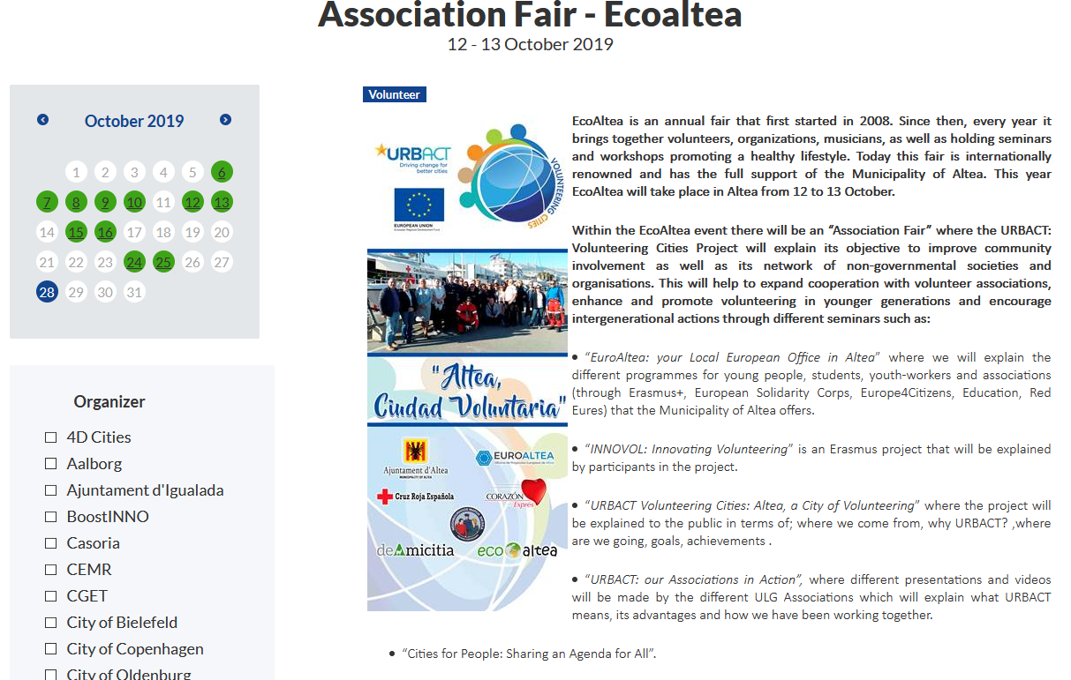

Slide 14
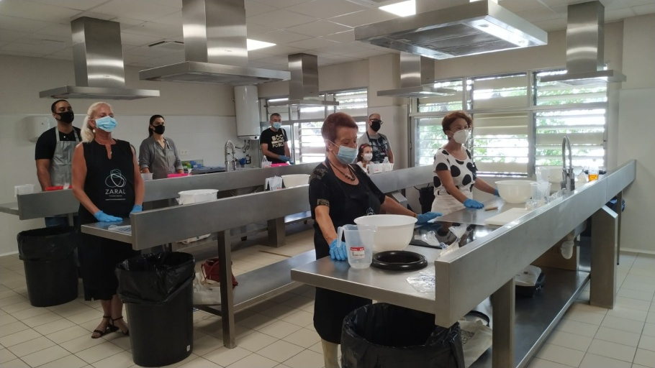
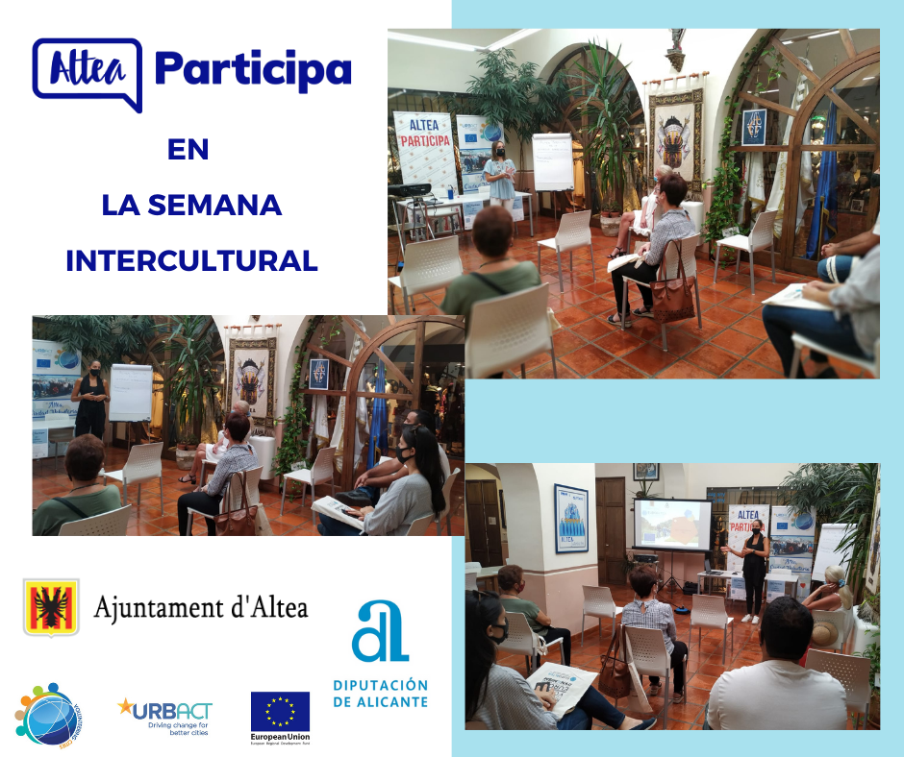
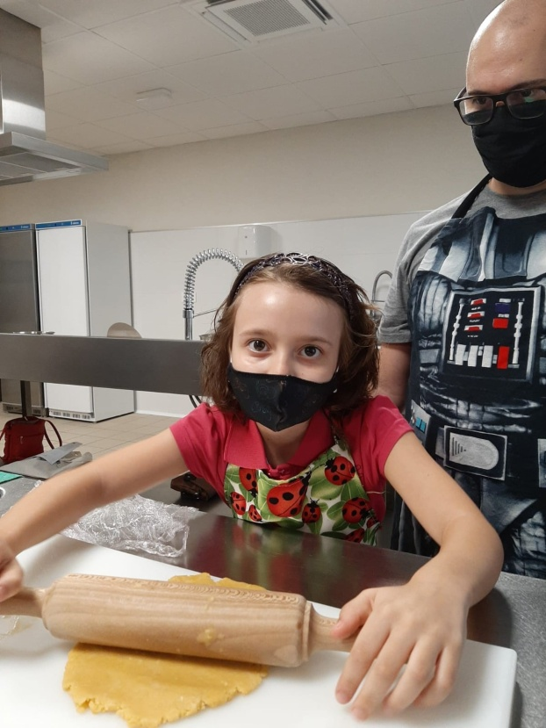

Slide 15
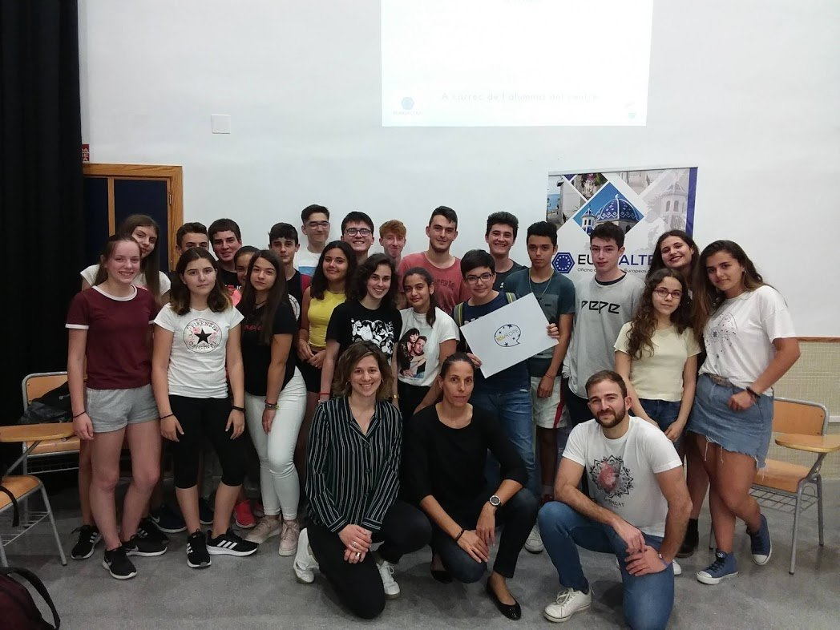
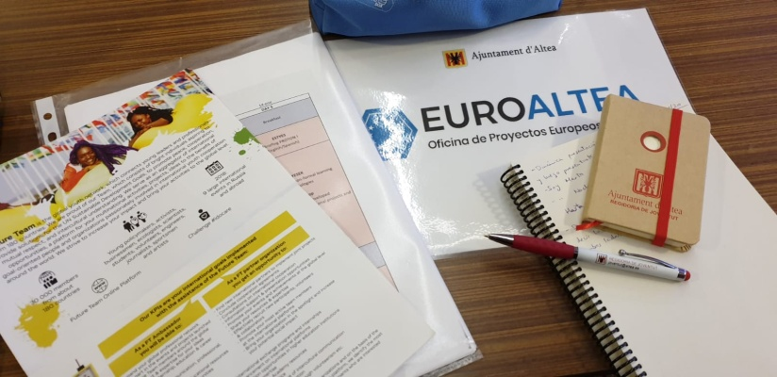
MODULE 3
YOUTH and Volunteerism
What has changed?
 | 1st January 2019
Individuals | Potential volunteers only know about big associations as Red Cross;
Organisations | Red Cross counts on a big group of young volunteers; De Amizitia counts on a big group of young volunteers. Most of them supported by Erasmus Program. Other local associations are smaller and don’t count on too much young volunteers;
City | Municipality promotes youth volunteering through Erasmus Plus projects; Municipality collaborates extraordinarily with some associations;
Transfer Networks_Towards Phase 2
Notes:
Your customised menu
15

Slide 16
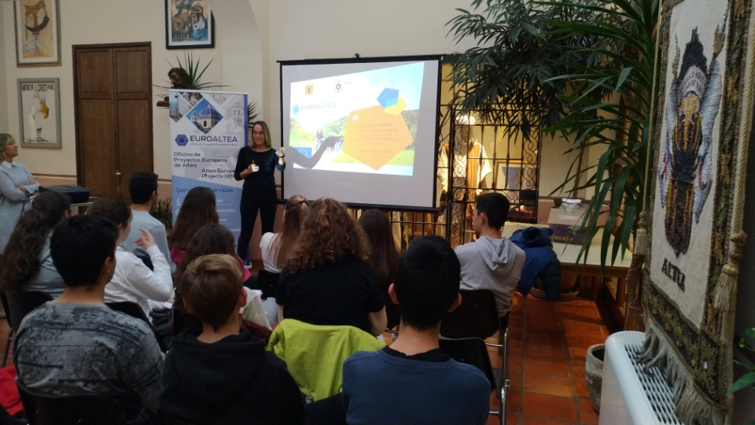
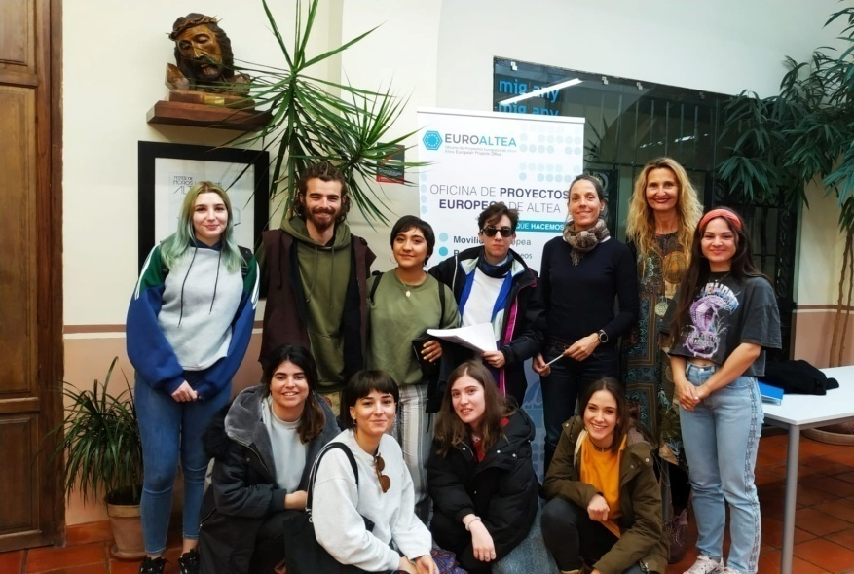
MODULE 3
YOUTH and Volunteerism
What has changed?
 | 31st December 2020
Individuals | All associations reached a good promotion thanks to URBACT project; Numbers of volunteers has increassed. Most of it during pandemic situation;
Organisations | URBACT project has contributed to a better dissemination of all associations; All associations have recieved a big number of new young volunteers. The highest number of new volunteers was reached during pandemic situation.
City | The City Council continue promoting youth volunteering by Erasmus Plus programs; The City Council distributed youth volunteering requests to all ULG associations; The City Council is creating a website for promoting Volunteering opportunities;
Transfer Networks_Towards Phase 2
Notes:
Your customised menu
16

Slide 17
MODULE 3
YOUTH and Volunteerism
Key Learnings
1.Individuals | 1.1. Increasing awareness and committment from Councelors and Technicians; 1.2. Increasing awareness and committment of departments as Youth, Education, Civic Participation and Social Affairs and its technicians; 1.3. Increasing awareness and committment of all key players of all local associations to work on youth volunteering approach; 1.4. Motivation about develop more youth projects or more opportunities for youth involvement. 1.5. It is needed to invest on better dissemination and promotion in order to increasse motivation and interest among young citizens.
2.Organisations | 1.1. Better coordination among organizations in order to better facilitate information to youngsters and distribute them in relation to their interests; 1.2. Increassing volunteering opportunities offer to youngsters; 1.3. Be open to new participants and new ideas from youngsters; 1.4. Discovering new opportunities as Erasmus Plus and European Solidarity Corps.
3.City | 1.1. Providing support on communication and dissemination in order to attract more young volunteers; 1.2. Supporting initiatives promoted by local associations in order to increase impact in young citizens; 1.3. Promoting Erasmus Plus initiatives in order to promote young volunteering;
Transfer Networks_Towards Phase 2
Notes:
Your customised menu
17

Slide 18
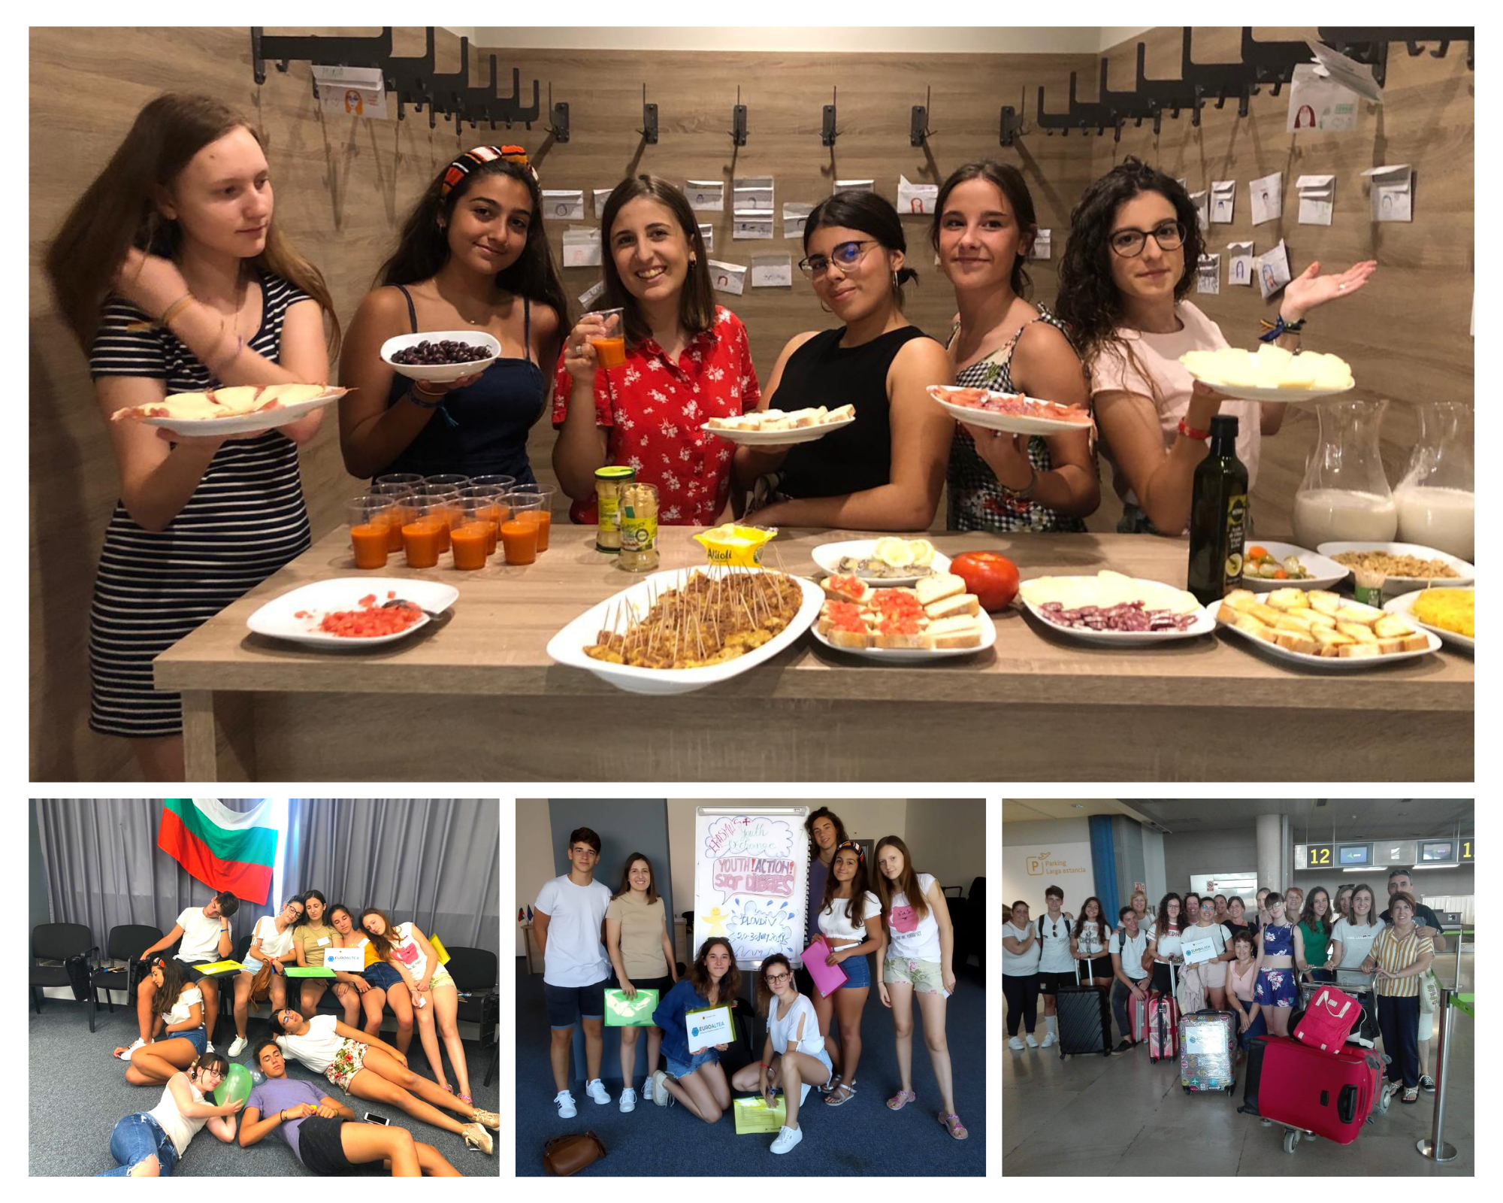

Slide 19
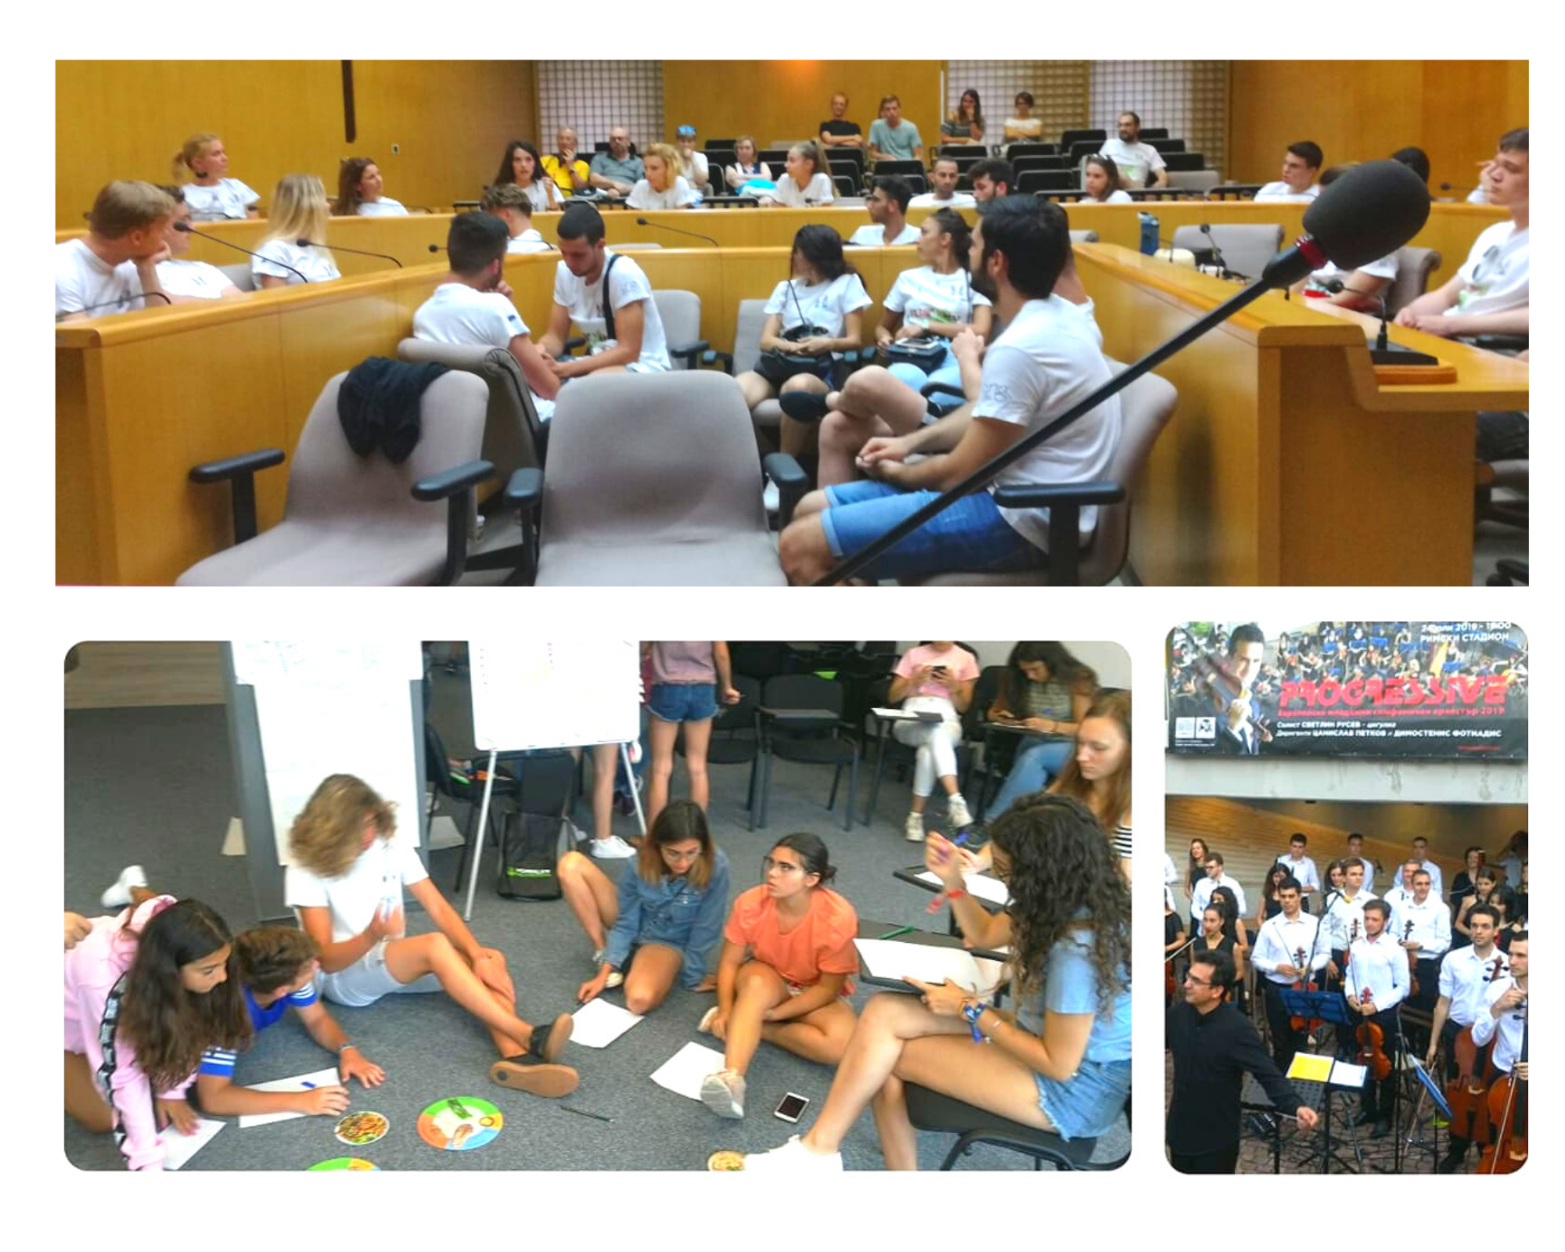

Slide 20
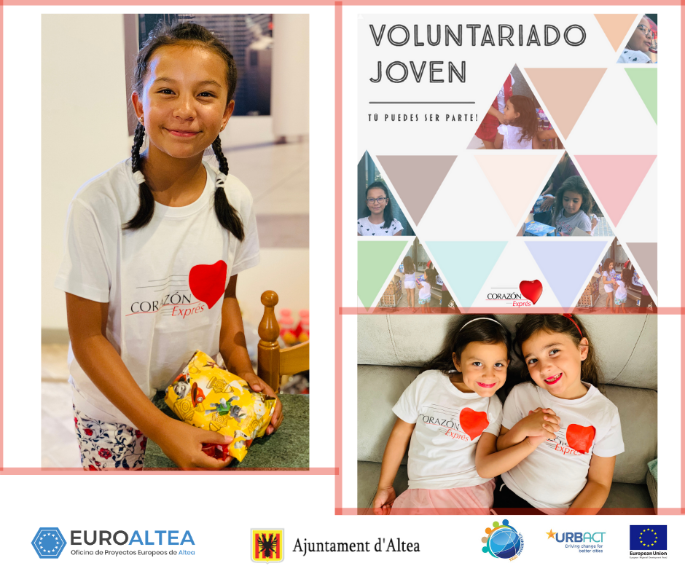
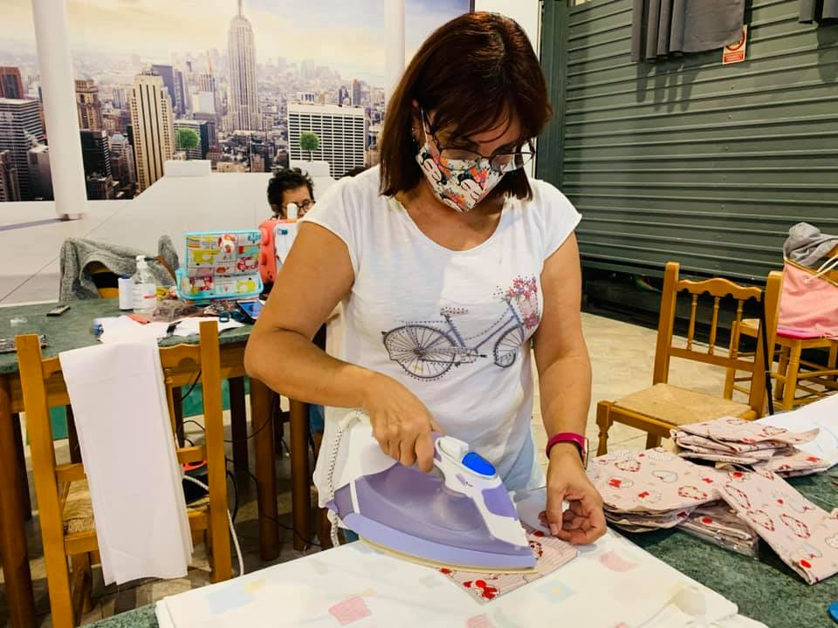
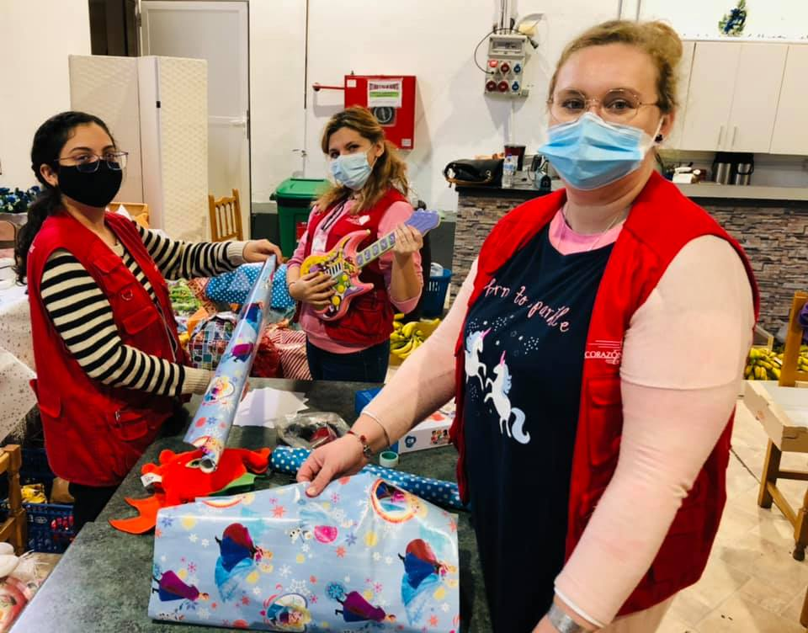
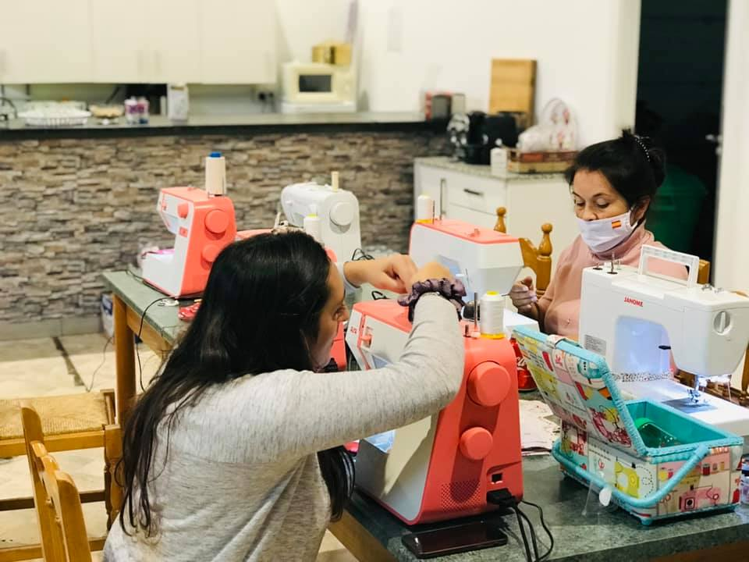

Slide 21
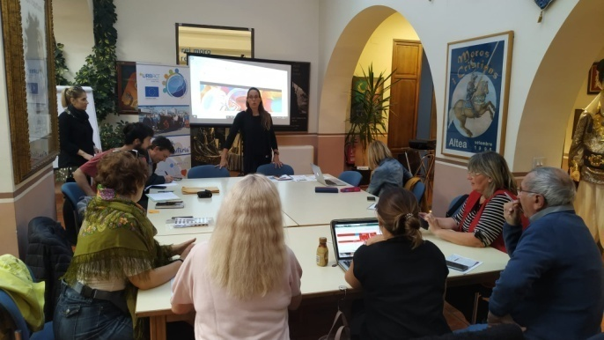
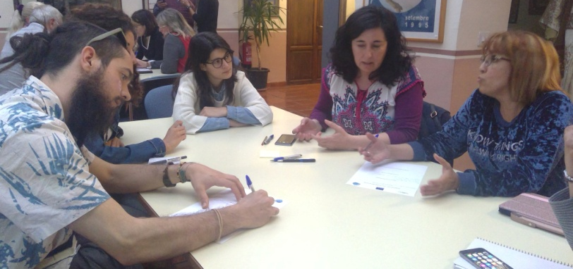
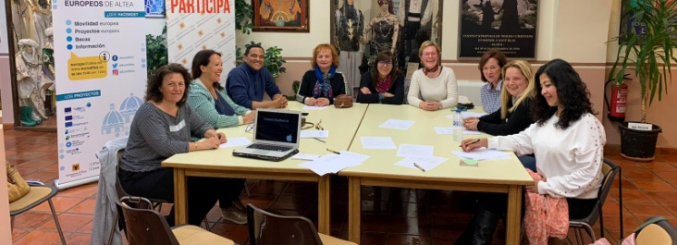
MODULE 4
Corporate Social Responsibility
What has changed?
 | 1st January 2019
Individuals | CSR was an unknown topic for most of ULG members;
Organisations | CSR was practically unknown in all involved organizations; Some organizations have some collaboration with SME but not formalized;
City | CSR was a unknown topic for the City Hall;
Transfer Networks_Towards Phase 2
Notes:
Your customised menu
21

Slide 22
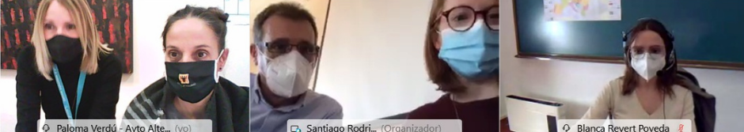
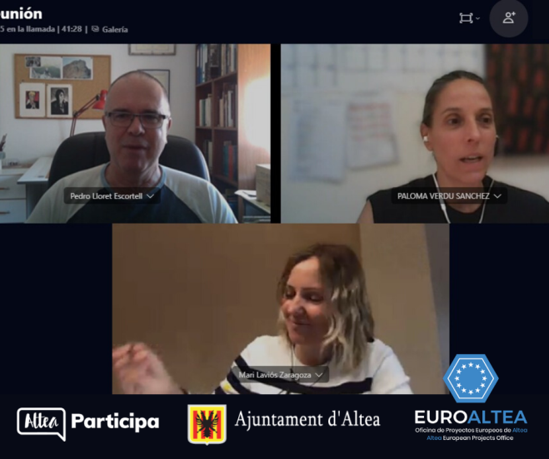
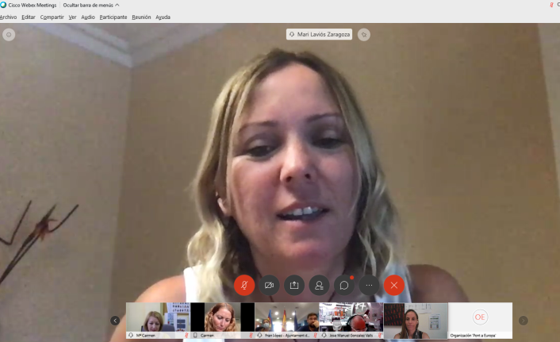
MODULE 4
Corporate Social Responsibility
What has changed?
 | 31st December 2020
Individuals | CSR was debated several times during ULG meetings and all participants are interested on it;
Organisations | Local associations are interested in participate in the City CSR plan that will be defined in 2021; Local associations would like to develop this work line and collaborate with local SME in terms of dissemination, promotion, etc;
City | City Countil is workin on a Participatory CSR Strategy that will be developed at the begining of 2021.
Transfer Networks_Towards Phase 2
Notes:
Your customised menu
22

Slide 23
MODULE 4
Corporate Social Responsibility
Key Learnings
1.Individuals | 1.1. Increasing awareness from Councelors and staff members; 1.2. Increasing awareness and committment of departments as Youth, Education, Civic Participation and Social Affairs and its technicians; 1.3. Increasing awareness and committment of all key players of all local associations to work on CSR; 1.4. Motivation about develop a common integrated Strategy for CSR. 1.5. Motivation to collaborate and establish synergies between SMEs, Associations and City Council.
2.Organisations | 1.1. Increasing awareness about importance of CSR; 1.2. Increasing their interest about establish synergies with SMEs; 1.3. Motivation to develop a common, integrated and participatory Strategy;
3.City | 1.1. The City Council will facilitate a common, integrated and participatory strategy for CSR, involving all associations and local SMEs; 1.2. The City Council could represent a main actor for promoting CSR at city level by initiatives and policies; 1.3. The City Council will collaborate with SMEs and Associations on promoting CSR.
Transfer Networks_Towards Phase 2
Notes:
Your customised menu
23

Slide 24
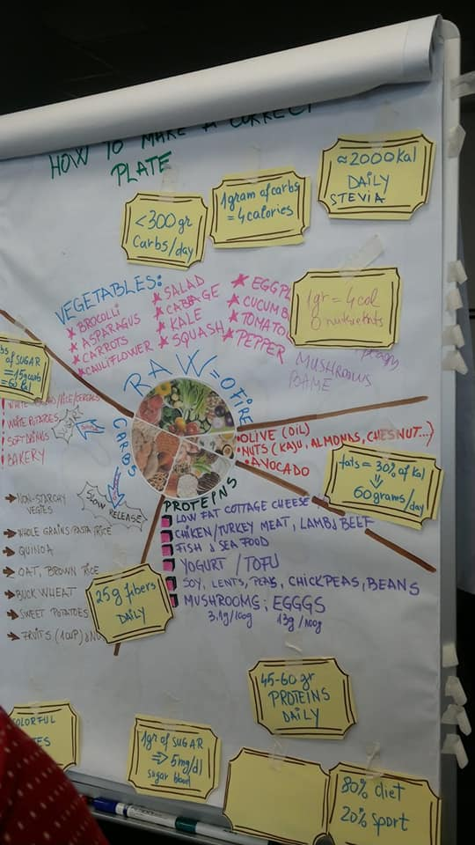


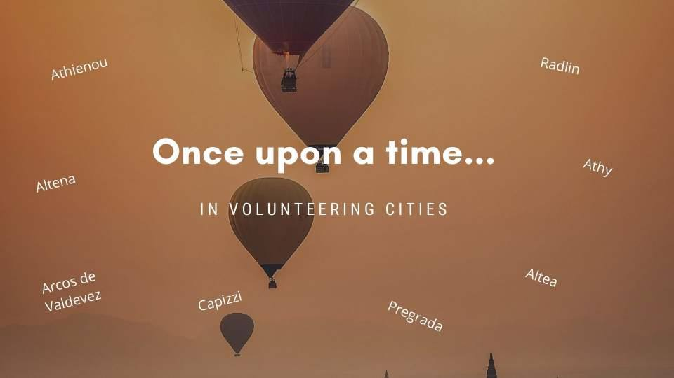
Our next step into 2021: CSR

Slide 25
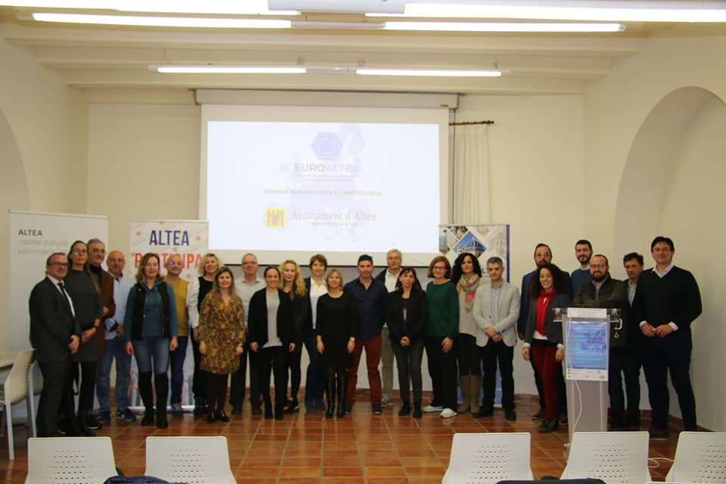
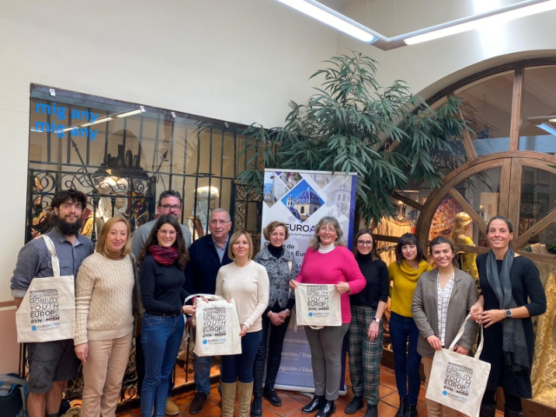
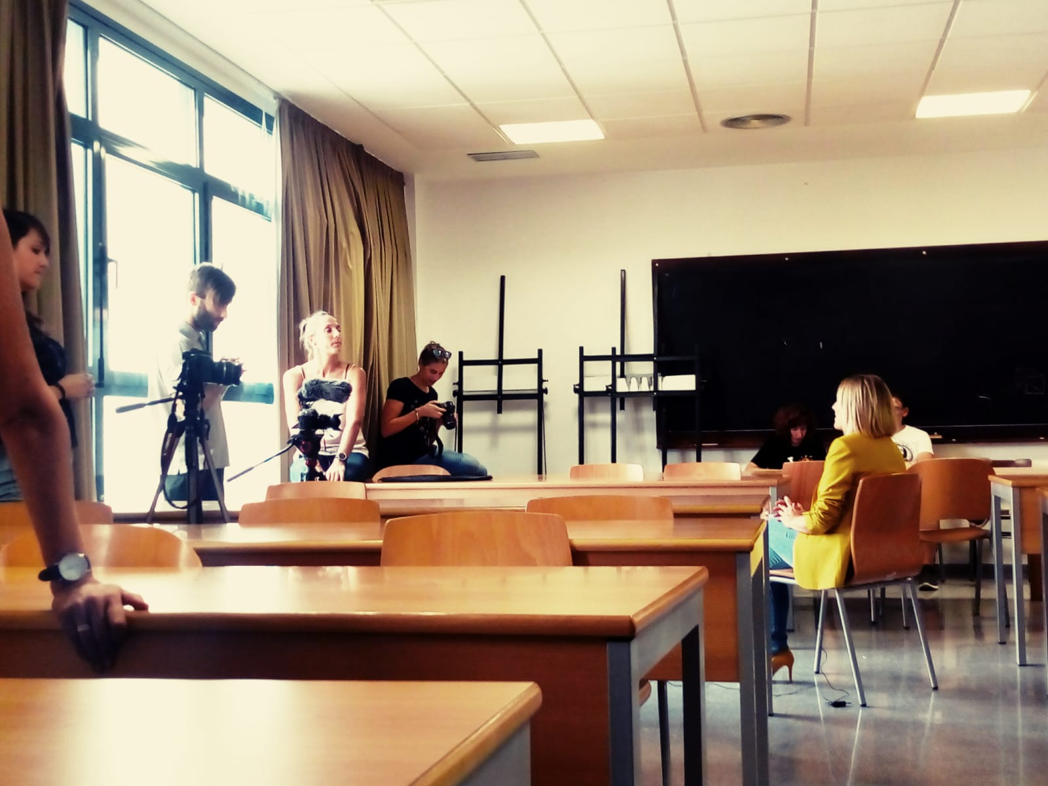
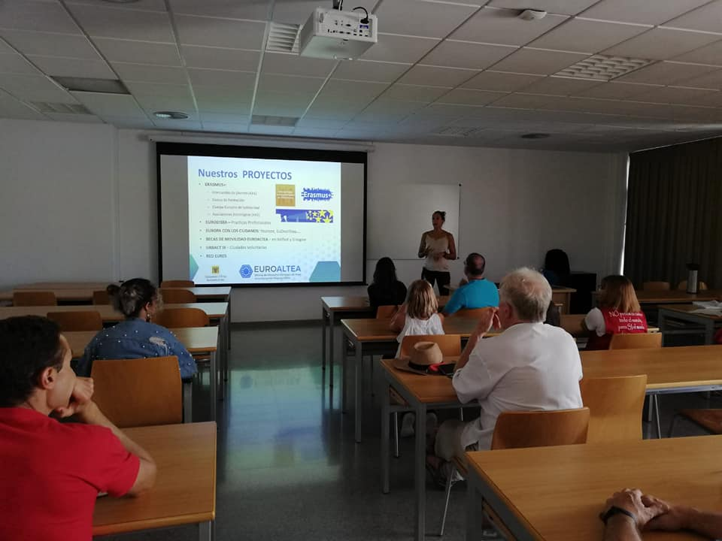
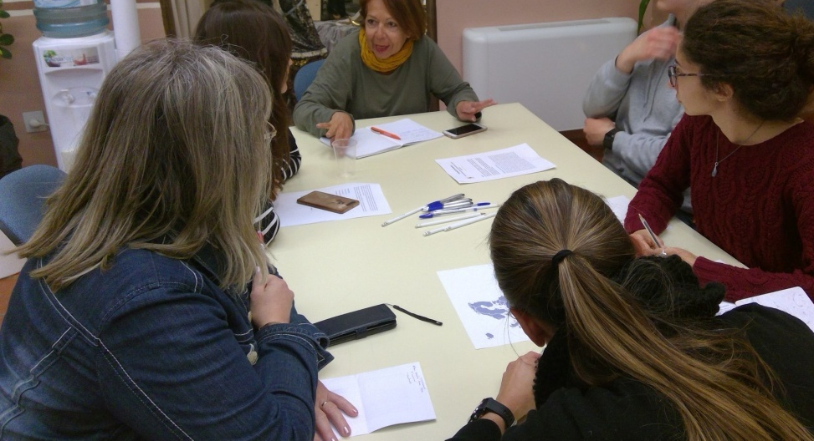

Slide 26
