Slide 1
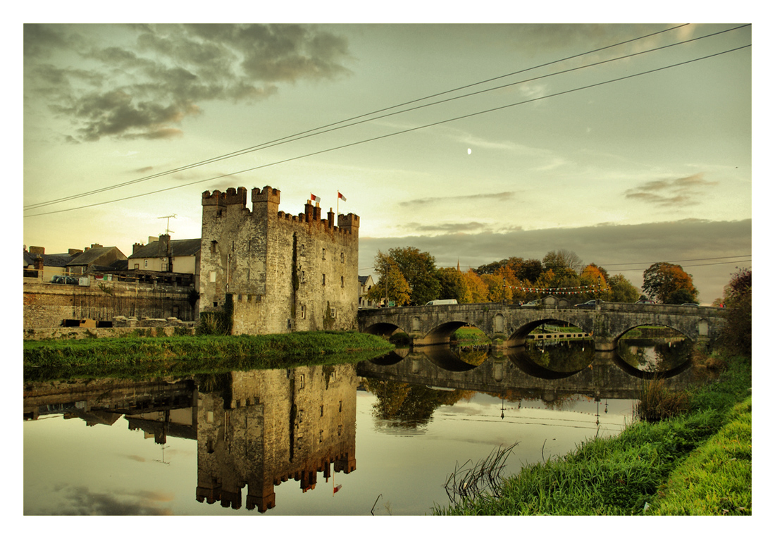
ATHY LEARNING LOG

Slide 2
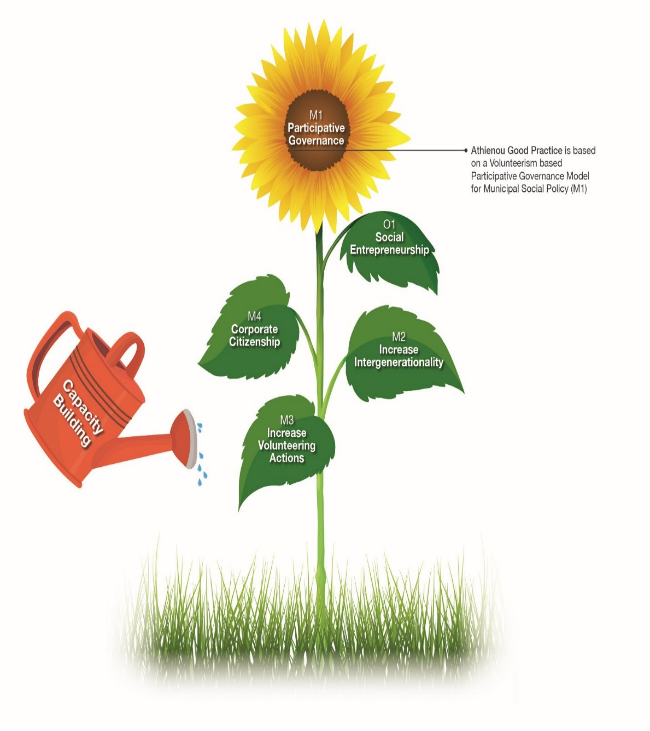
ATHY LEARNING LOG

Slide 3
ATHY LEARNING LOG
2019
Organisation
Issues showed that work needed to be done around strengthening, training and stronger policy development, along with promotion of opportunity to gaining volunteers for other groups.
Community
Volunteer Centre needed to gain more exposure in Athy. Develop connections between individuals interested in volunteering and form group who had opportunities and did not engage with the centre.
Individuals
Little involvement of certain sector of society. Signposting of where to go and how to get involved in the community for those who wish to give of their time especially new- comers to town.
2020
Organisations
Innovation: Bigger presence of volunteer centre in activities in town. Collated volunteer response during the pandemic.
Community
Strengthened: Greater understanding of volunteer contribution to society and the organisations that assist certain sector of society. Better recognition of Volunteer work in town.
Individuals
Strenghtened: Very big improvement in participation in volunteering in Athy. Over 600 individuals put their names forward to assist and help out in Athy in 2020
What we learned
A more focused approach to volunteerism in Athy. Greater participation of Kildare Volunteer Centre. Work around training and policy development delivery required, key piece around supporting both individuals and organisations. Wider promotion and appreciation of Volunteerism as a very valuable piece of work in a good functioning society.

Slide 4
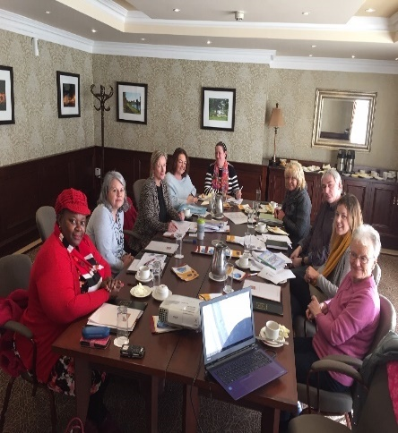
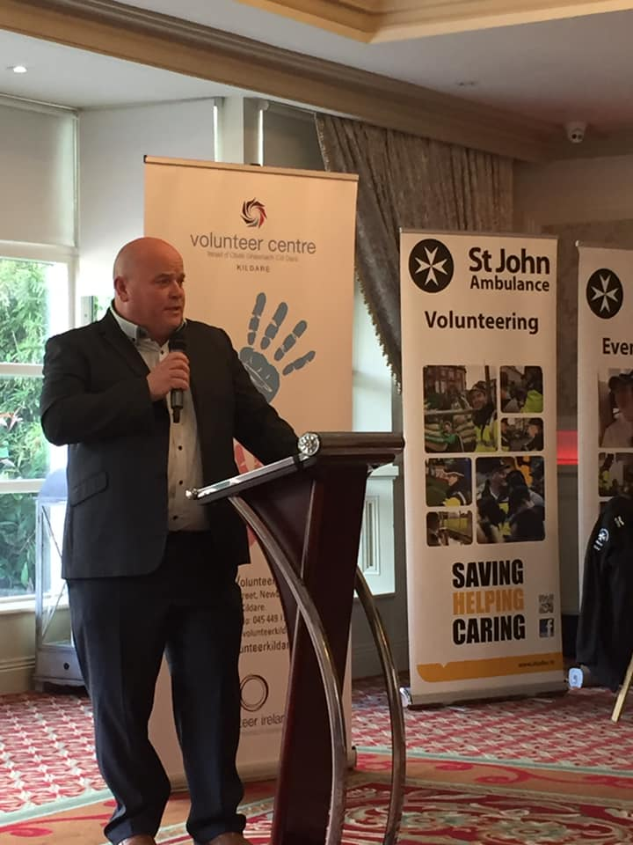
ULG Meeting
ATHY LEARNING LOG
Mayor of Athy opening address at volunteer network forum in Athy

Slide 5
ATHY LEARNING LOG
Transfer Diary “URBACT Transfer Diary of Visit to Arco de Valdevez, Portugal. The learning from this programme over the few days has been both interesting and educating. The sharing of common experiences and ideas from the various representatives of countries throughout Europe, has been inspiring and refreshing. Within the group there is an openness and enthusiasm to create better communities in struggling disadvantaged towns. Key woods/processes I took from the 2 days were Transfer Plans, Transfer Treasure Box, Inter-Generational opportunities, Volunteering.” Michelle Kildare Volunteer Centers | Individual 2019( Bernard) “Fantastic to be involved with the Volunteer forum. It is something that needs to be done annually to keep groups and individual connected in society and to keep the spirit of volunteering alive. It is good to know there is a specifics group dedicated to volunteerism in Athy and look forward to participating in the next event. 2020 Ogranisation. (Sharon) “ URBACT has allowed the needs of the individuals and groups to be addressed in a safe environment. Collaboration around the table has had a positive impact on certain individuals and working groups in society. | Community Sean Community Garda. “Athy shone when the need arose during the pandemic. Athy had more volunteers offering to support the older person than any other area of the county as per feedback form interagency meetings. Individual Noreen “ It is very important to make an effort to look after those in our community, especially the needs of the older person. One of the best consequences of the dinner service is that our older people get to meet a friendly face every day – guaranteed.”

Slide 6
ATHY LEARNING LOG
M2 Intergenerational
2019
Community
Intergenerational activity was not on many agendas in Athy before this project started.
Organisation
While there was some youth engagement especially around festivals and events there was room to improve on this opportunity.
Individual
Difficulty in knowing what was available around town when it came to participation in volunteering activity for any age group.
2020
Organisation
Strengthen: links with older people. Young children for the Gael Scoil school kids made Christmas and Birthday Cards for clients of St Vincents Hospital and Clover Lodge Nursing Home. Due to Covid interaction reduced.
Innovation: and Collaboration: Lions Club worked with Ard Scoil Tranode Secondary School on their food appeal. The kids brought in food along with the Lions Club collection and they packed and disributed the food parcels to Saint Vincent De Paul.
Community
Innovative: Intergenerational supports. All age groups supported the older person in the community around preparation of meals and delivery of meals to the older person cocooning.
Individual
Collaboration: Silent Santa drive by for Special Needs Group Kids in Athy area. December 2020

Slide 7
ATHY LEARNING LOG
M2: Through the project’s deep dives, site visits to Atheniou and Pregrada the matter of intergenerational work has shown Athy ULG that this module is a very important and valuable piece of work for society. Intergenerational visits to Nursing homes by Kindergarten’s helps both generations. It can help improve the health and wellbeing of Dementia and Alzheimer’s patients
The URBACT project showed how transferrable this module was. Athy ULG visited the nursing homes and kindergartens to engage with both sectors and transfer the learning. There has been improvement in engagement, The Community College singing class entertain the older people in the nursing home. The Scouts collected donations and delivered Christmas presents to all the ward. The Suzuki Music school for young children played a concert for the nursing home clients. Athy ULG intends to roll out this module to every Kindergarten and school in the area. This good practice transfer module was innovative, it strengthens links, built bonds within our communities, around groups and individuals.
Meeting in Altena was very interesting around the model of the Knerling project. How the older person built the functioning train set and the Scalextric to attract young people to engage with them. A very clever idea and very impressive. Also, they provided a charity shop for immigrants to support their needs in a new country.
A lot of learning taken for all transfer networks and deep dives.

Slide 8
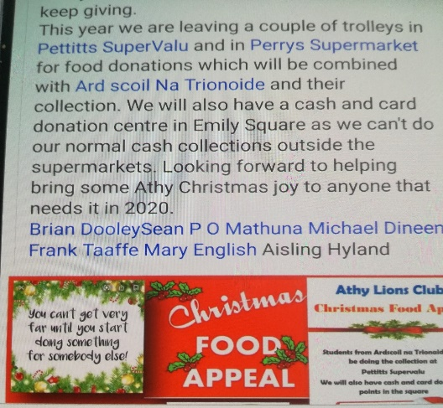
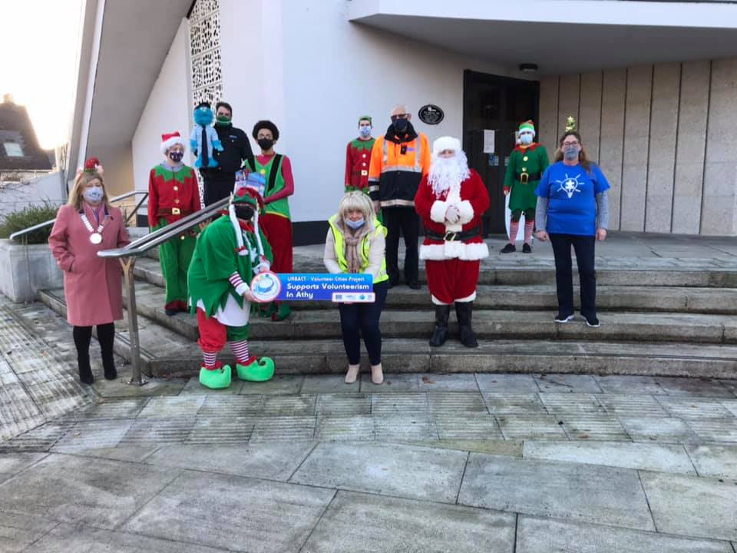
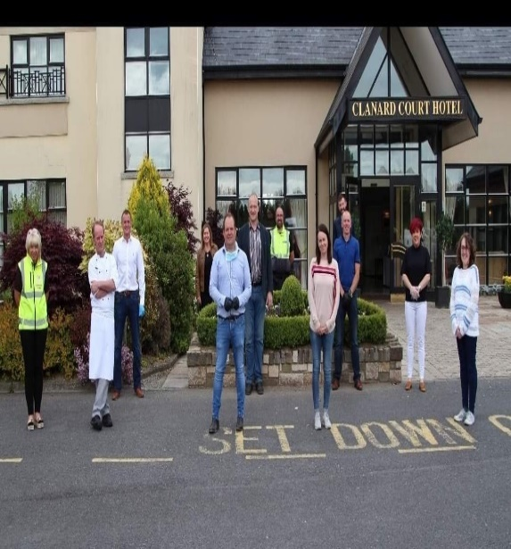
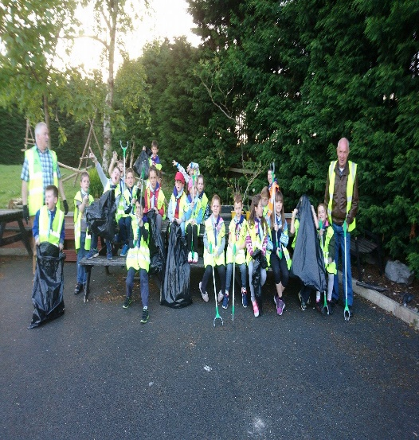
ATHY LEARNING LOG
M2: Lions Club Food Appeal in conjunction with Ard Scoil Trionoide
Silent Santa for the Special Need Group in town
Printing of booklet to suppport the older person keeping in contact with family and friends through social media channels.
Work carried out by the Gael Scoil kids and Garda Youth Diversion Project kids designing cards for the elderly
Group of Hotel, Restaurants and Coffee shops with volunteers who feed the older person every day as they self isolate in their homes. Volunteering at its best
Athy Tidy Towns chairman and school class on a clean-up venture in Athy.

Slide 9
ATHY LEARNING LOG
M3 Youth Volunteering attracting young people to volunteerism
2019
This element of the project was about building opportunities for younger people and making them available and more attractive for them to get involved in society.
Community
Not many groups of children participated in previous Town parades.
Individual
Hard to find opportunities to get involved with organisations around clean ups and civil good in the community
Organisation
Engagement with young people was mainly inhibited because of legislation.
Opportunities for young people under 18 were unavailable due to shortage of summer camps in town.
2020
Organisation
Innovative: solution by Athy Town Promoters to get young children involved in St Patrick’s Day parade and to Halloween festival with special emphasis on children for Council Estates participating in events. All events start at the later end of town where the most socially excluded are based.
Collaborative: work with youth group, Men’s Shed and Willow Service around Allotment Regeneration Project and integration piece.
Individual
Communication: River and community cleanups advertised and available to all to get involved in.
Community
Strengthening: of community spirit through summer camps and clean up for young people.
Engagement: Kildare Youth Service engaging in Erasmus as an avenue to volunteer working.

Slide 10
ATHY LEARNING LOG
M3: Athy did not perceive to have many opportunities around youth volunteers. The deep dive in Altea showed the Youth volunteer opportunities through Erasmus. Athy engaged with Erasmus on the receiving end but did not really send students back across the water. Kildare Youth Services expressed an interest in getting involved in this piece of work.
Listening to the young person opens opportunities for young people to get engaged in programmes and allowing them to pick what they wish to do in society.
Athy Tidy Towns provides ample opportunities for residents and young people to litter picking and clean up along river walkways. This inter-generational piece of work encouraged young people to get involved in looking after their own area.
Strengthening connections in society with increased involvement of young people in different projects in town.
I like the different projects we did in the area. They are really cool and creative. I felt proud of myself for taking part in the projects and seeing all of the people looking at them around the town.” – Participant on An Caisleán Garda Youth Diversion Project, Athy Castledermot area.
Aoife “Athy Town Promoters run 5 events per year and young people are very much encouraged to participate more in society. St Patrick’s Day Parade, Teddy Bears Picnic, Halloween Event, turning on of Christmas Lights, Shop Local and support Triathlon, Dragon Boat Events. There is ample opportunity for young people to engage with events and volunteers in Athy.”
Ger” Collaboration between Tidy Towns schools and residents’ groups is very good. Tidy towns 5-year plan built in provision to create more volunteer opportunities and encourage youth volunteerism. A special award is given out each year for youth endeavor activity.”

Slide 11
ATHY LEARNING LOG
Transfer Diary
“I like the different projects we did in the area. They are really cool and creative. I felt proud of myself for taking part in the projects and seeing all of the people looking at them around the town.” – Participant on An Caisleán Garda Youth Diversion Project, Athy Castledermot area.
Aoife “Athy Town Promoters run 5 events per year and young people are very much encouraged to participate more in society. St Patrick’s Day Parade, Teddy Bears Picnic, Halloween Event, turning on of Christmas Lights, Shop Local and support Triathlon, Dragon Boat Events. There is ample opportunity for young people to engage with events and volunteers in Athy.”
Ger” Collaboration between Tidy Towns schools and residents’ groups is very good. Tidy towns 5-year plan built in provision to create more volunteer opportunities and encourage youth volunteerism. A special award is given out each year for youth endeavor activity.”
Tidy Towns Young Volunteer of the year 2020 (Luke Doogue)

Slide 12
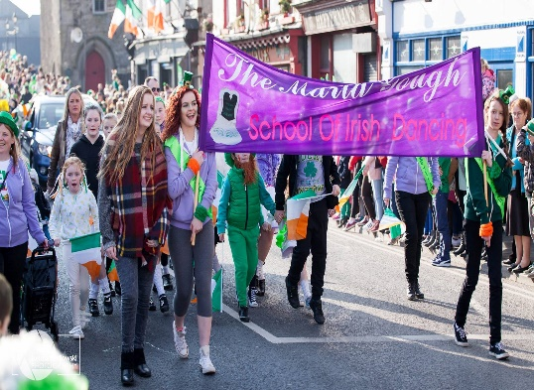
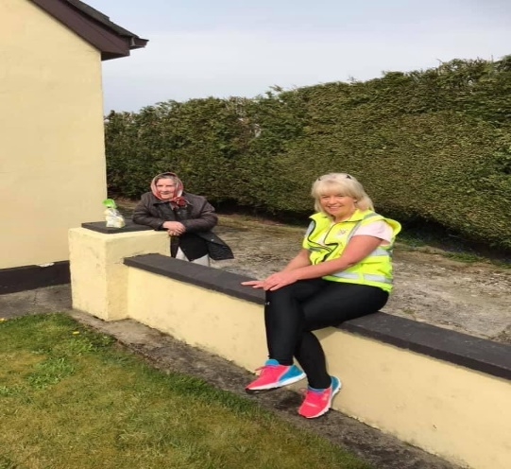
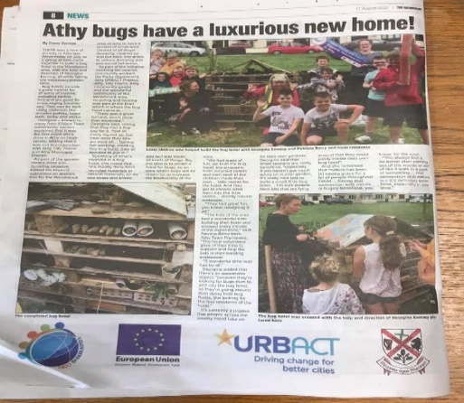
ATHY LEARNING LOG
Kids participating in events
Bug Hotel kids camp makes the paper
Activity building bug hotel
Intergenerational house visit

Slide 13
ATHY LEARNING LOG
M4 Increase Corporate Social Responsibility
2019
Community
Ad hock support for festivals and events in town. Need for foster better links between community and business in town.
Organisation
Unknown philanthropy in town? how can organisations benefit from such supports?
More promotion required for corporate to supports local groups and not National Organisations. Work needs to be done on “think local is best”.
Individual
Businesses needs to support events and give back to the community. This approach it could benefit their business in the future
2020
Community
Strengthening: Corporate support sourced for main events in town
Organisation
Strengthening: A picture emerging on Corporate supports to groups in town.
Individual
Innovation: A reality of working together to build a brand for the town under Shop Local Campaign with prizes donated from the business and raffled to give to the community

Slide 14
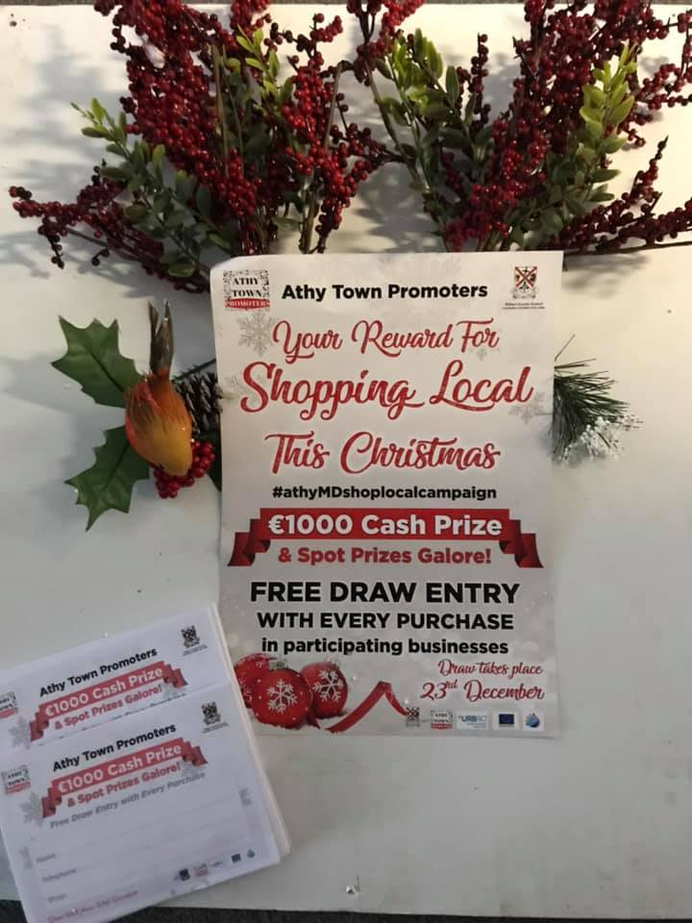
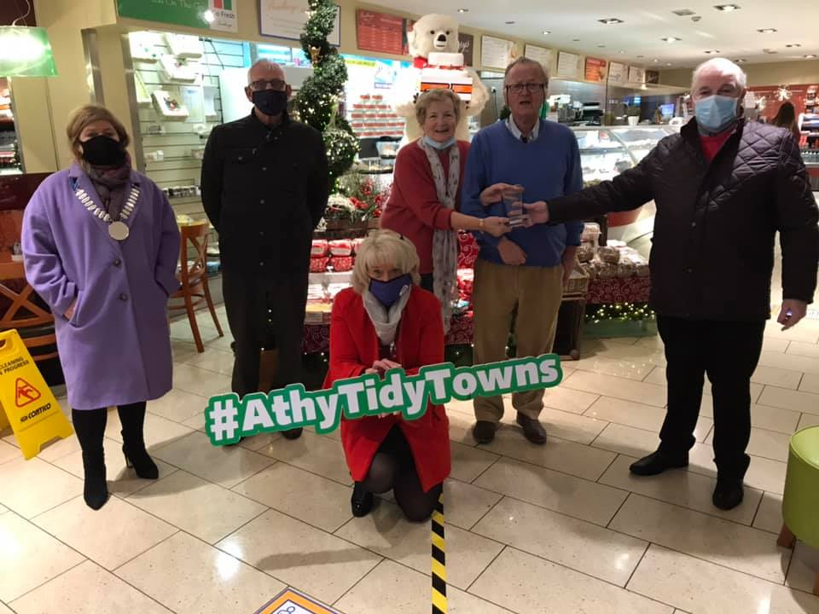
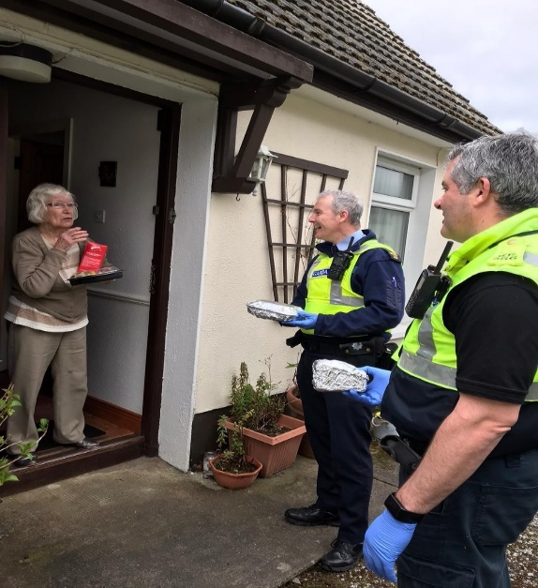
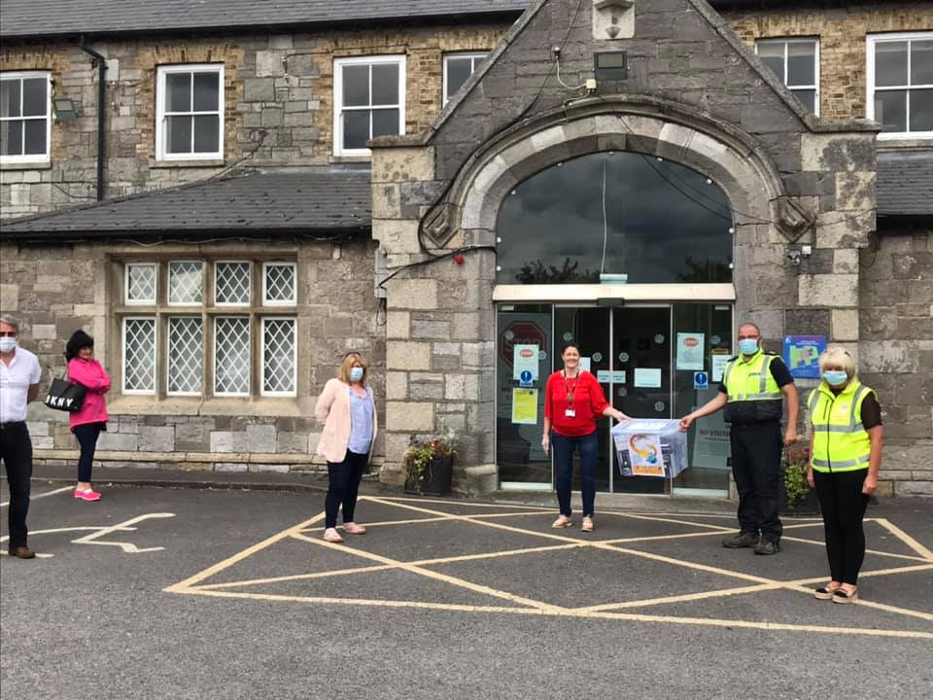
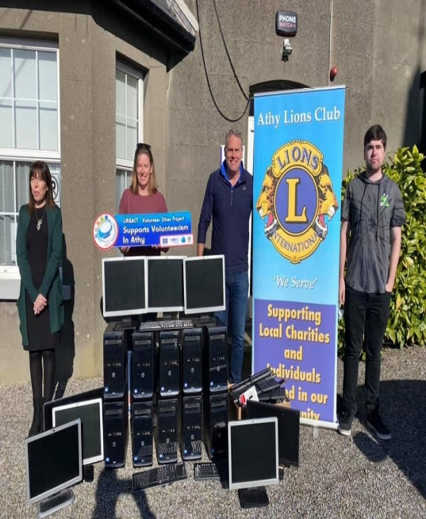
ATHY LEARNING LOG
Hot daily dinners for the elderly
Shop local campaign supported by businesses in town
Tidy towns best business award
Community Garda delivering dinners
Supports from business to local nursing home
Lions club donation of computers to training centre.
Louis Roberto’s presentation on Corporate Social Responsibility (CSR) was both informative and interesting. It provided the extra knowledge of linking CSR to the 17 SDGs which many of the corporations had signed up to.
The aspect of linking relevant SDGs to CSRs is an important learning which when successfully implemented will benefit companies and the communities where they operate. Athy stands to benefit from such collaboration.

Slide 15
ATHY LEARNING LOG
Social Enterprise
2019
Community
Little opportunity to engage in social enterprise activity in town.
Individual
Cannot see how participating in social enterprise could support a CV and job search into the future.
Organisation
Feasibility study needs to be carried out to see what would make a difference to the older person around remaining comfortably in their own home for as long as possible.
2020
Community
TUS and CE Scheme engage with long term unemployed around work in community groups and local NGO’s
Individual
people on TUS and CE scheme were afforded opportunities to set up own business and to transfer into long term employment
Organisation
Audit returned huge need to support the older person under Kildare Small Jobs Programme Supervisors and staff positions created.

Slide 16
ATHY LEARNING LOG
What we Learned
Acros DE Valdez deep dive presented on the Ugly Fruit social enterprise which was most interesting.
Exploration on Wool craft revival was tried but did not generate enough interest to continue with the concept.
Supports to the older person staying in their own home, came up as a great need. As Kildare Leader Partnership had the brief under Social Enterprise Nicola form the Partnership carried out a feasibility study on the need and it came back as a positive need. The partnership was successful in securing a CE Programme to train young people around maintenance and repairs in the older persons home ensuring better quality of life.
Transfer Diary
Chris Mc Kenna “I have been part of a few network meeting. The networking visits to social enterprises was of great interest to me. The Knerling project had 2 such projects and the Stellwerk volunteer group were involved in many social enterprise such as the swop shop.
Through the visit and learning it has shown me as a volunteer how valuable the volunteer effort is to every communtiy.”
Helen “Athy ULG will Identify gaps in the social structure and look at setting up a Social Enterprise to deliver change. Athy Boat Tours is a social enterprise which is a success in Athy and addressed the lack of a tourism product on the river in town. Other opportunities will present themselves “.

Slide 17
ATHY LEARNING LOG
Acros De Vladez INCUBA Site Visit
Athy Boat Tours Social Enterprise

