Slide 1



URBACT Infoday
URBACT IV call for Action Planning Networks
Notes:
URBACT IV (2021 – 2027)

Slide 2
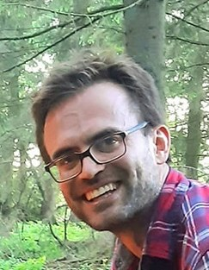
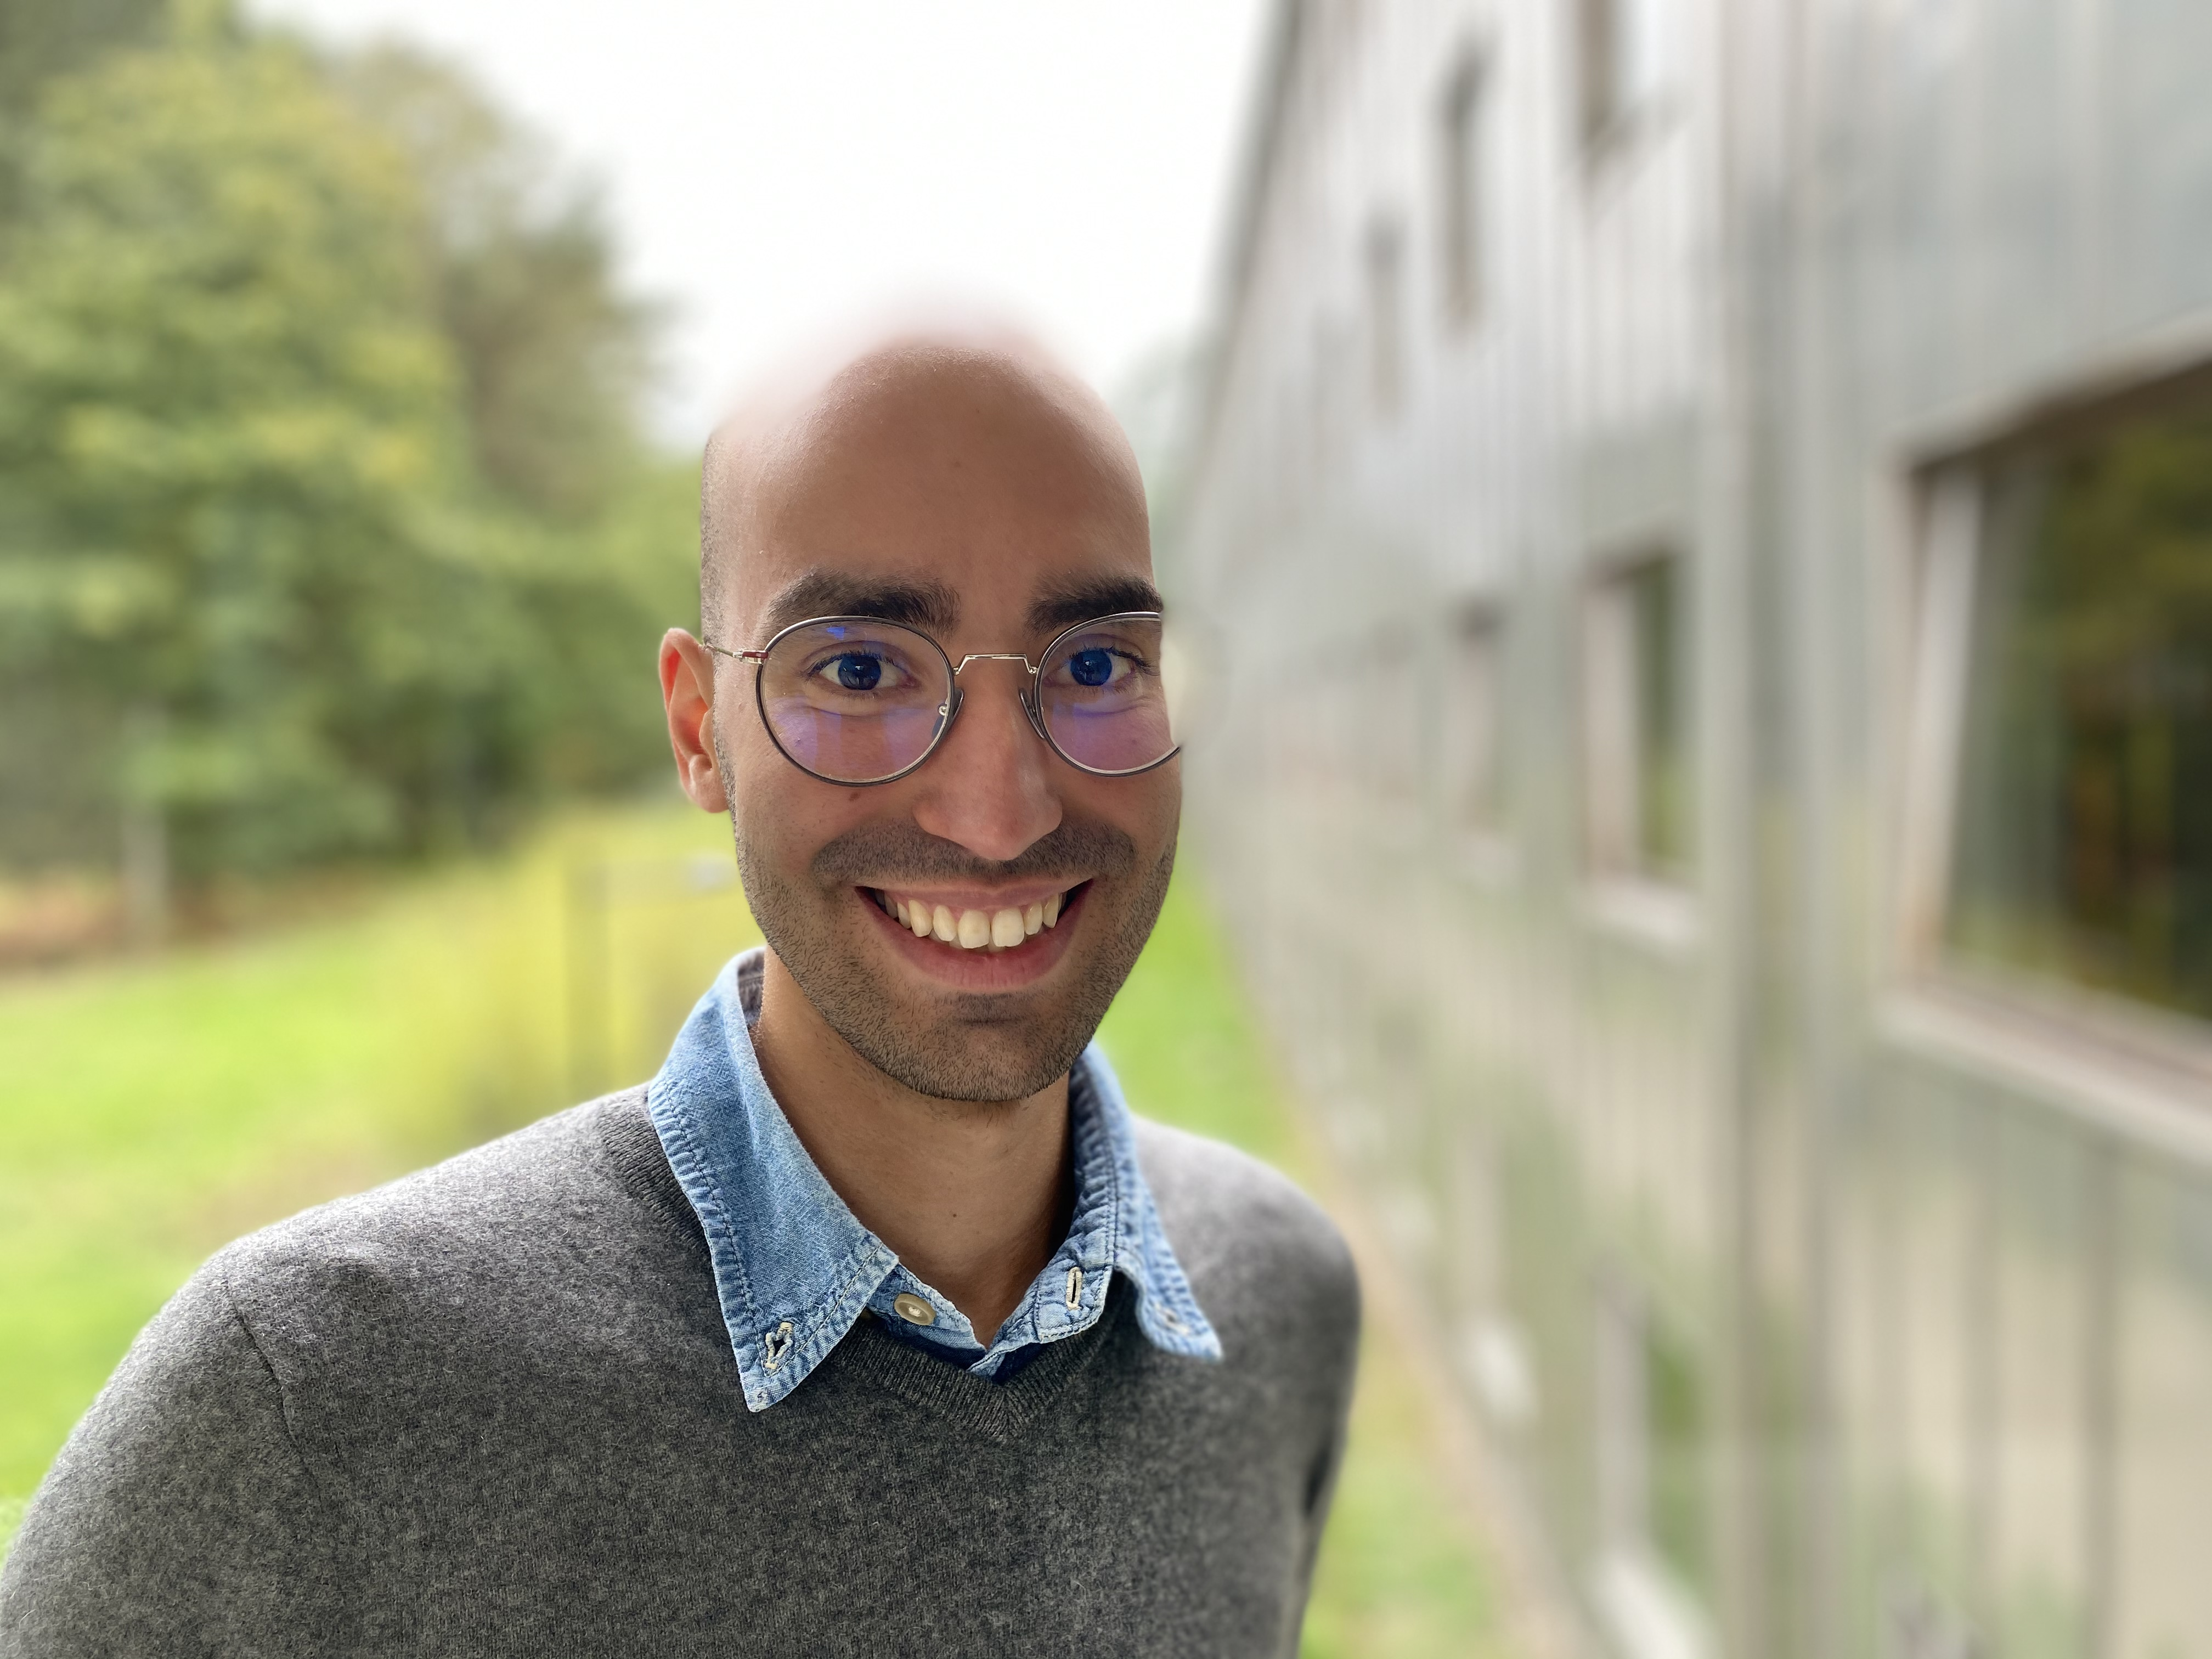
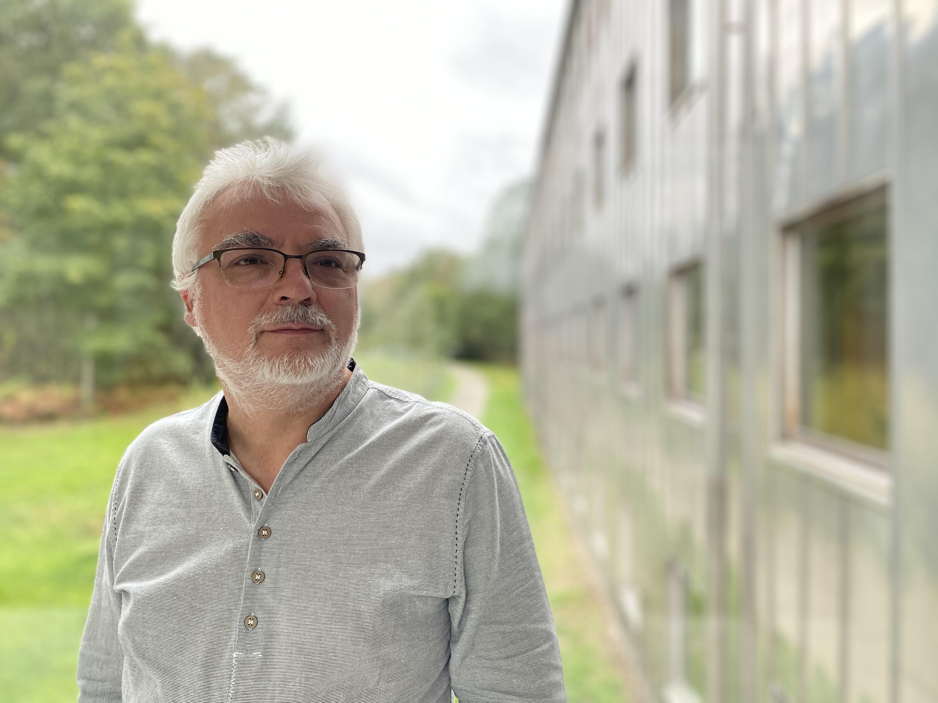


National URBACT Point representatives
Tom Goosse – UGent
Fabian Massart – ULiège
Bruno Bianchet – ULiège

Slide 3
Today’s schedule
14:15 - 14:45
14:45 - 15:45
15:45 - 16:00
16:00 - 17:00
URBACT, integrated actions for sustainable development
Some feedbacks
Housing solutions to end homelessness - Juan Leclou
Urban resource centers for a more circular economy - Julie Poppe
A transition to more sustainable food - Marcelline Bonneau
Break
All you need to know about the new "Action Planning Networks" Call

Slide 4
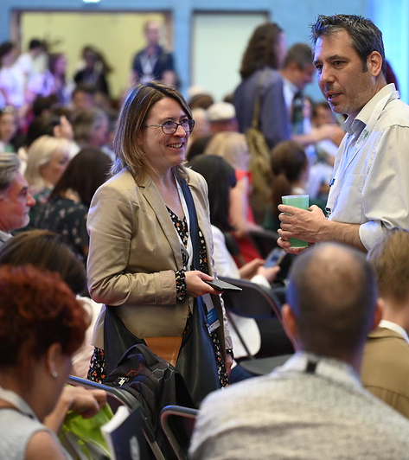
1) URBACT, integrated actions for sustainable development

Slide 5
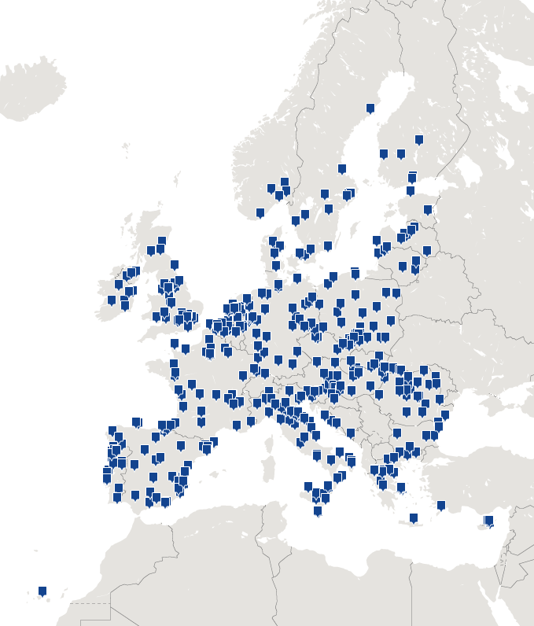
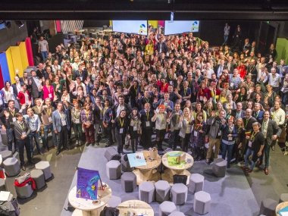
European territorial cooperation programme co-funded by ERDF
Over
1000 cities involved
more than
150
networks
Since 2002
Promoting sustainable urban development in cities

Slide 6
The main objectives of URBACT
Promote Integrated Sustainable Urban Development through cooperation
Enhance institutional capacity of public authorities and stakeholders to implement territorial strategies
Contribute to Policy Objective 5 of the European Regional Development Fund (ERDF) – Europe Closer to Citizens by fostering sustainable and integrated development
Notes:
Main objectives of the programme:
To promote Integrated Sustainable Urban Development through Cooperation
Enhance the institutional capacity of public authorities, in particular those mandated to manage a specific territory, and of stakeholders
Target audience: European city administrations (city staff, policy-makers, decision-makers, urban practitioners)

Slide 7
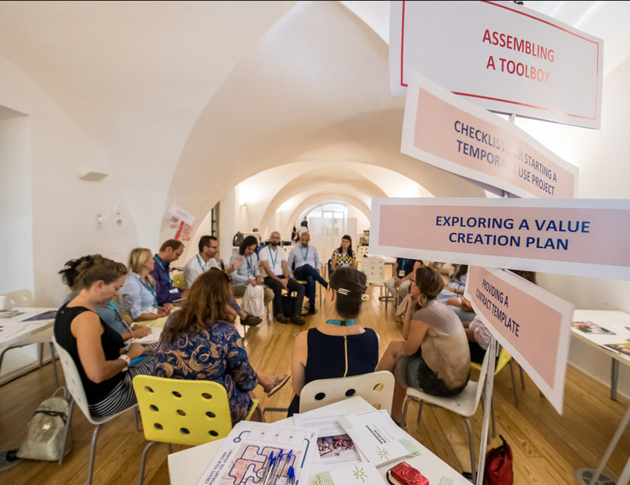
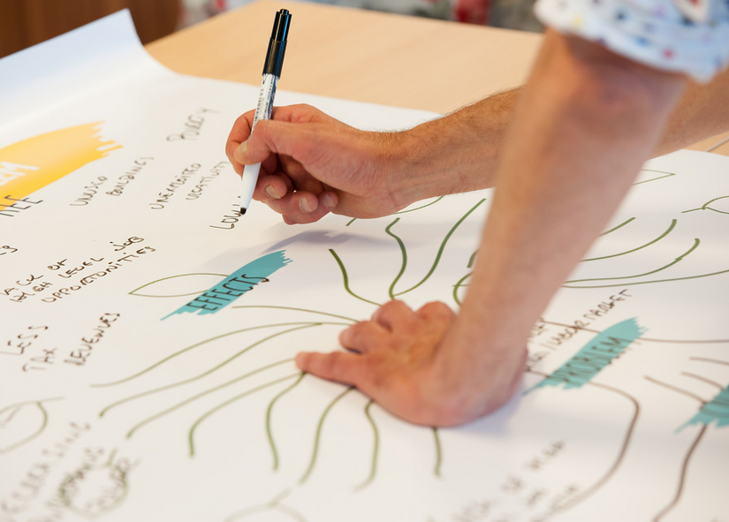
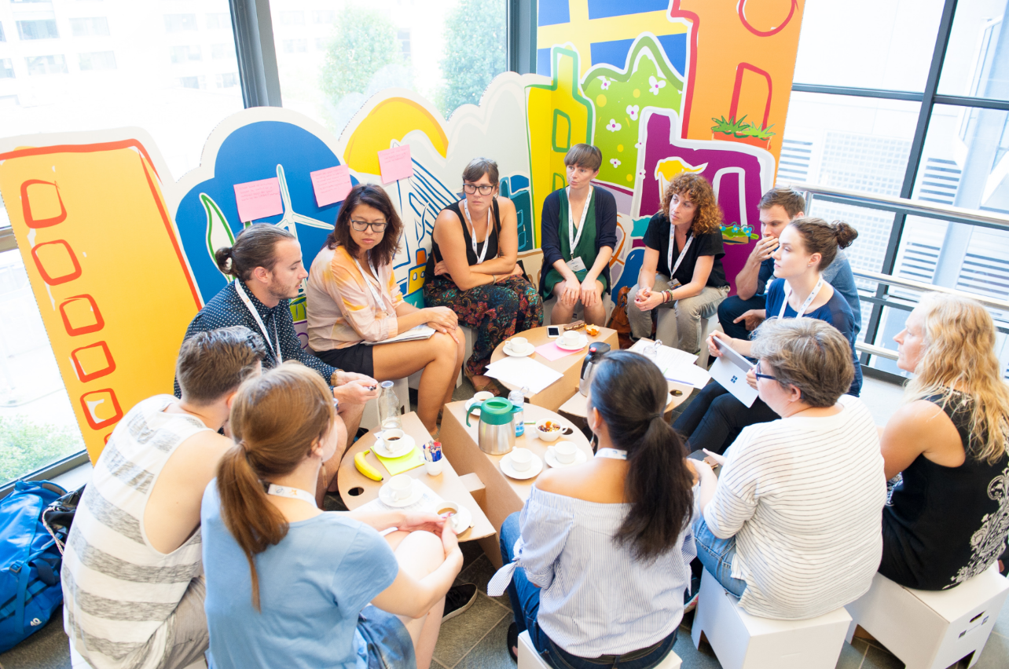
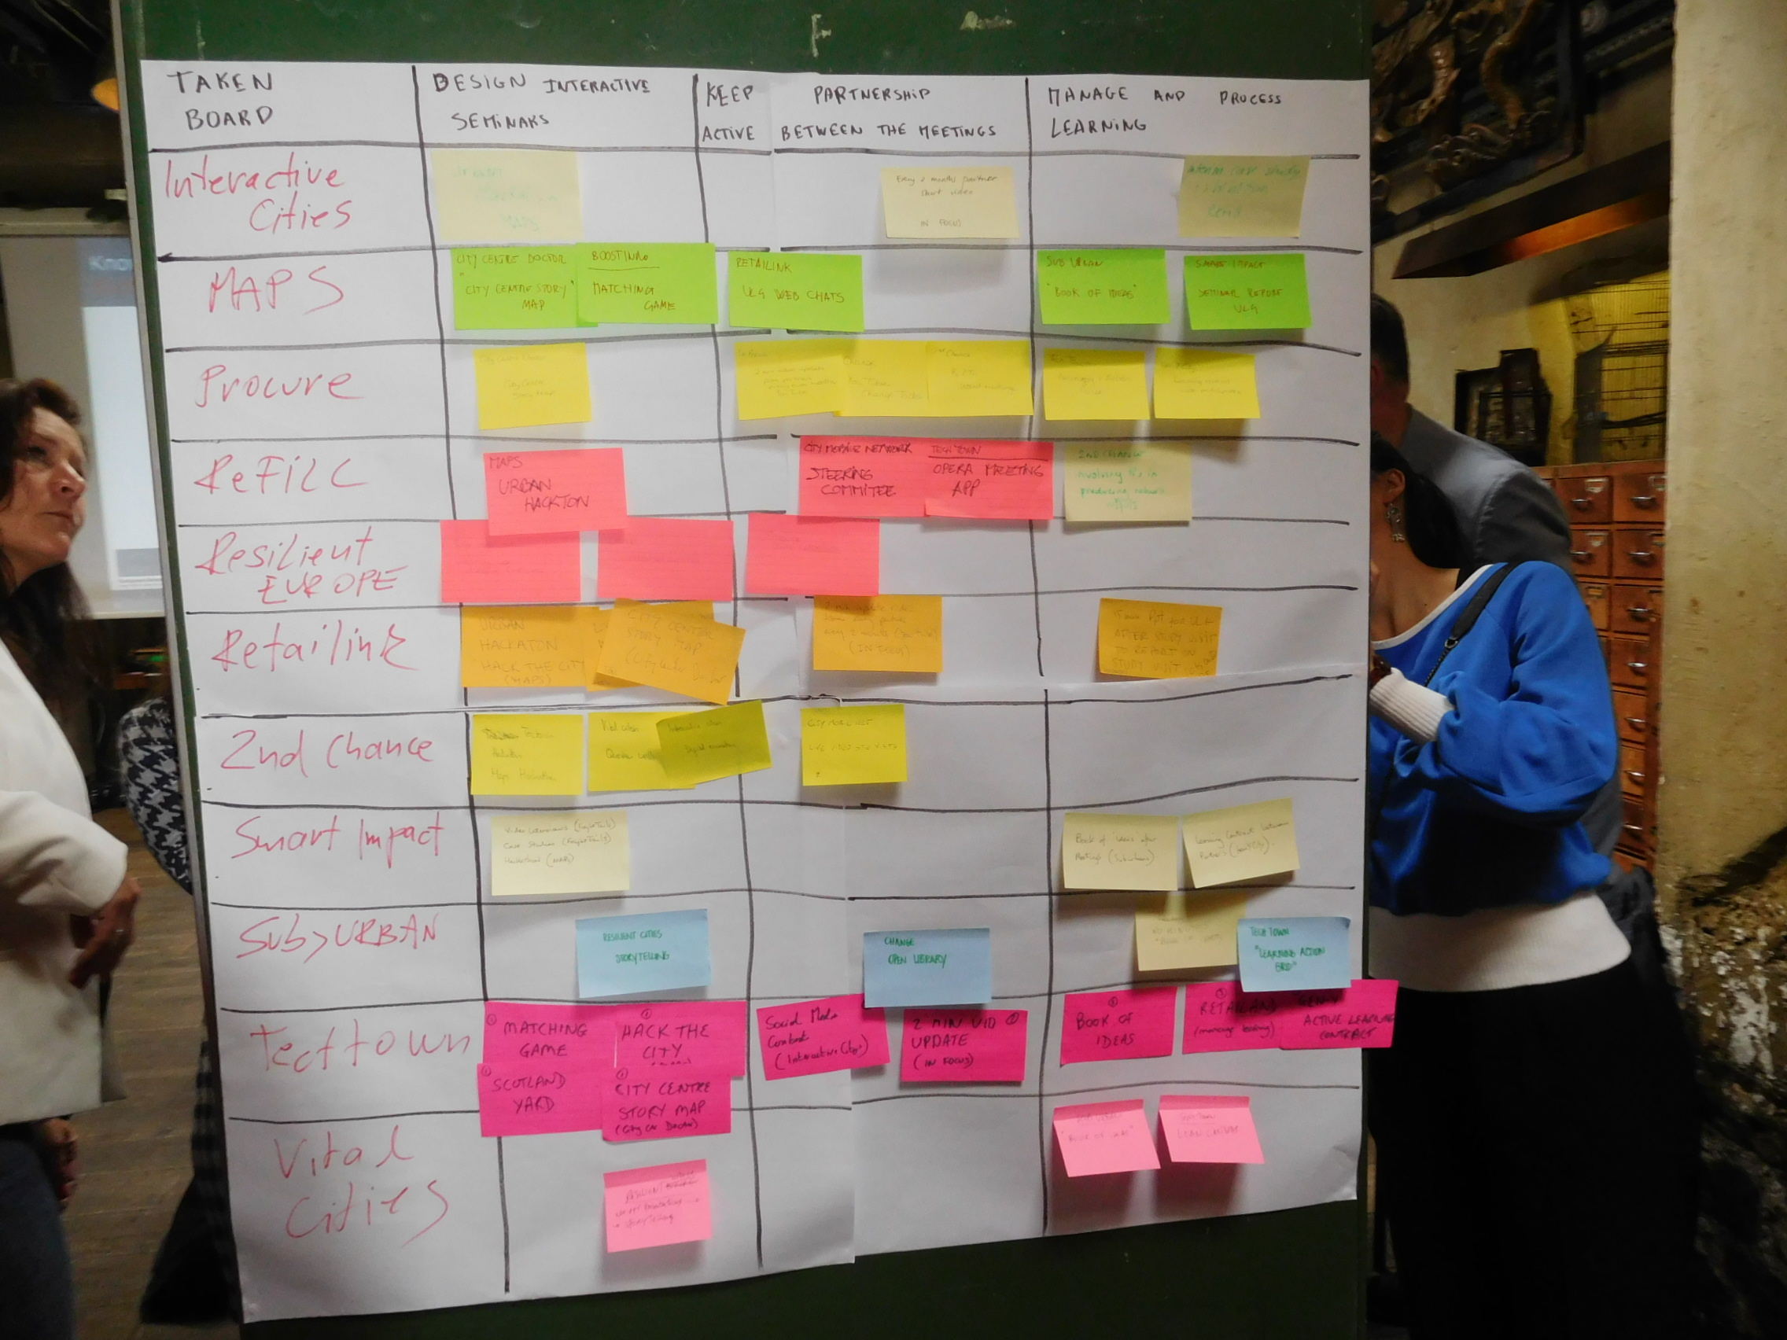
URBACT is… driving change for better cities
With the URBACT Method:
Integrated approach - considering all dimensions of sustainable development
Participation in practice - engagement of relevant stakeholders and citizens
Transnational exchange - connecting cities and learning from peers
Tailor-made support - network experts, methods & tools, learning by doing

Slide 8



URBACT has… 3 strands of activities
Networking
Capacity building
Communication
Knowledge-sharing
Between cities
Between stakeholders
Community of practice and learning
Knowledge uptake & dissemination

Slide 9
Different types of networks
Action Planning networks - facing a common challenge coming together to develop Integrated Action Plans
Transfer networks - adaptation and transfer of URBACT labelled Good Practices to other municipalities that have similar challenges
Innovation transfer mechanism - city networks that elaborate investment plans for replicating elements of Urban Innovative Actions
Networking

Slide 10
URBACT III global debriefing for Belgium
City of partner | Partner organisation | APN I | APN II | IN | SDG | TN I | TN II | UTM | Total
Antwerpen | Antwerp | 2 | 1 |  |  |  |  |  | 3
Bruxelles/Brussels | Brussels mobility | 1 |  |  |  |  |  |  | 1
Bruxelles | Bruxelles | 1 |  |  |  |  |  |  | 1
Gent | Gent | 2 | 1 | 1 |  | 1 |  |  | 5
Kortijk | Intercommunale de Leiedal |  |  | 1 |  |  |  |  | 1
Leuven | Leuven |  |  |  |  | 1 |  |  | 1
Liège | Liège |  | 1 |  |  |  | 1 |  | 2
Mechelen | Mechelen |  | 2 |  |  |  |  |  | 2
Mouscron | Mouscron |  |  |  | 1 |  |  |  | 1
Ostende | Ostende |  |  |  |  | 1 |  |  | 1
Roeselare | Roeselare |  |  |  |  |  | 1 |  | 1
Schaerbeek | Schaerbeek |  |  |  |  |  | 1 |  | 1
Seraing | Eriges Seraing |  |  |  |  | 1 |  | 1 | 2
Strée | GAL pays des condruses | 1 |  |  | 1 |  |  |  | 2
Vilvoorde | Vilvoorde |  | 1 |  |  |  |  |  | 1
2014-2020 programming period
21 project partners
4 lead partners

Slide 11
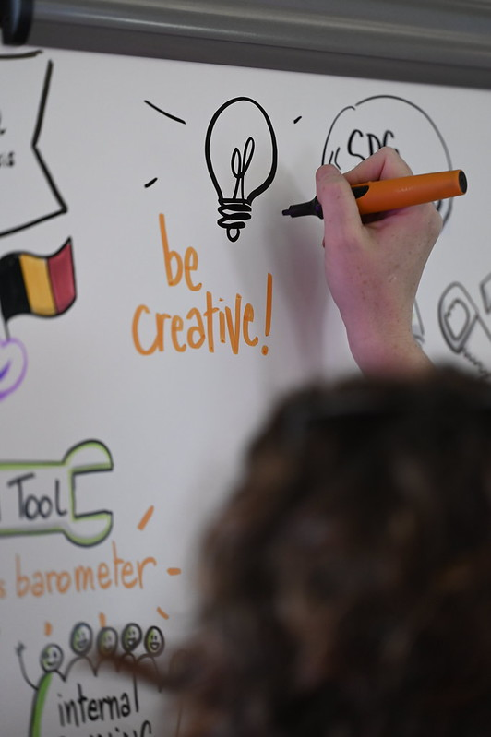
2) Some feedbacks
Experiences from URBACT III

Slide 12
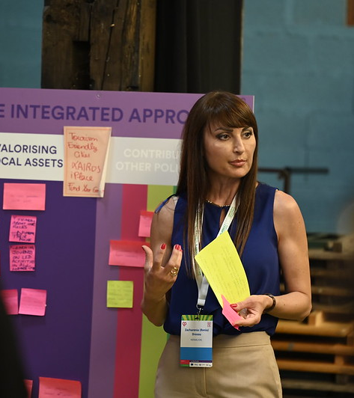
3) All you need to know about the new APN Call

Slide 13

Action Planning Networks
A group of cities facing a common challenge coming together
to develop Integrated Action Plans for their cities

Slide 14
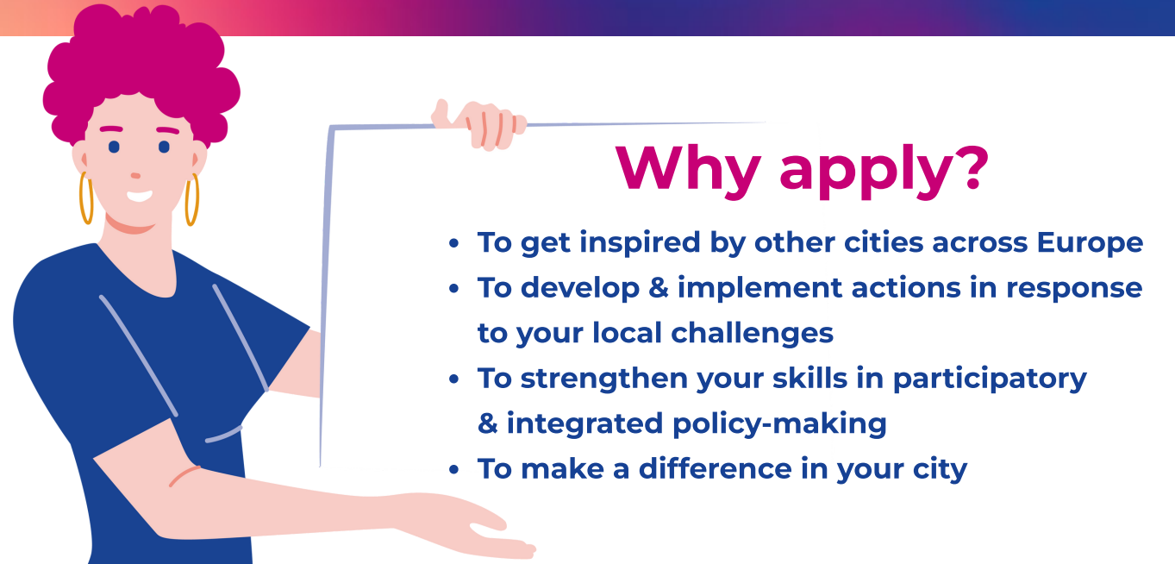
OPEN TO ALL THEMES/ POLICY CHALLENGES
Notes:
want to be empowered to tackle an urban policy challenge by exploring pertinent solutions through the production of an integrated action plan
want to make a difference in your city and ensure the sustainable transformation through concrete actions
wish to improve or change local policies by sharing experiences and exchanging knowledge with other European cities working on similar challenges
are eager to involve relevant key stakeholders and practice participatory culture by learning new tools and methods for effective policy-making
need a safe space for experimentation of innovative approaches for integrated city management processes and organisational impact

Slide 15



Open to all policy challenges
In line with EU Cohesion policy objectives
The identification of the policy challenge to be addressed in the network is an initial key step when preparing an application
+ Cross – cutting aspects to be considered in the proposals:
GENDER
GREEN TRANSITION
GENDER
DIGITAL TRANSFORMATION
DIGITAL TRANSFORMATION
Notes:
URBACT supports networks in any thematic issues on better cooperation governance. The present Call for Proposals for Action Planning Networks is open to any specific urban challenge or topic of shared relevance in line with the candidate cities’ local needs, as long as this falls within the scope of the Cohesion Policy objectives.
While addressing the main topic the URBACT networks will choose to work on, they will also have to reflect on how their activities and action plans address the cross-cutting aspects of green transition, digital transformation, and gender-inclusive approach. Whether cities aim to address mobility issues, cultural heritage, financial engineering, energy transition or any other topic, URBACT invites to take the extra mile and consider how these holistic themes can be part of the analysed challenges and solutions.

Slide 16
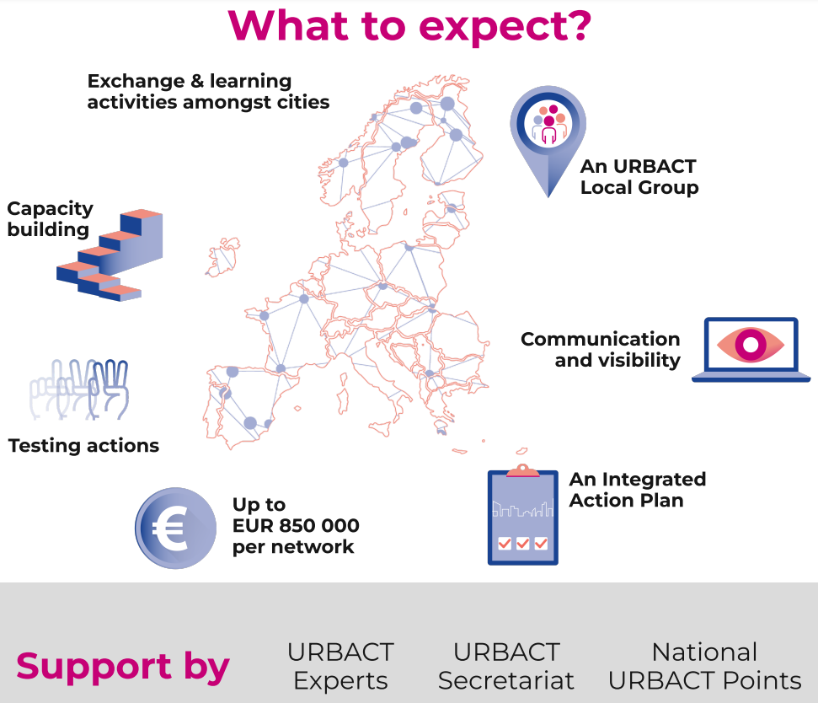
Notes:
from this visual we are missing the expert support with additional budget. it is important to mention this in addition

Slide 17
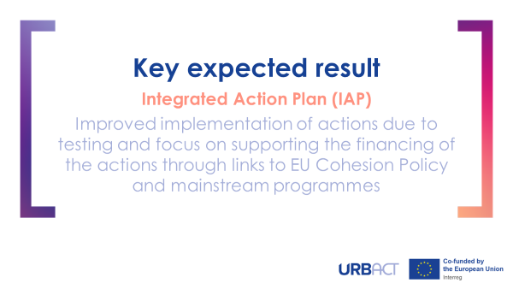
Key expected result
Integrated Action Plan (IAP)
An IAP offers cities a concrete response to their policy challenge. The IAP follows an intervention logic which aims to design and implement actions based on testing. The IAP will link the cities actions to the broader Cohesion Policy funds to support long term implementation and lasting change.

Slide 18
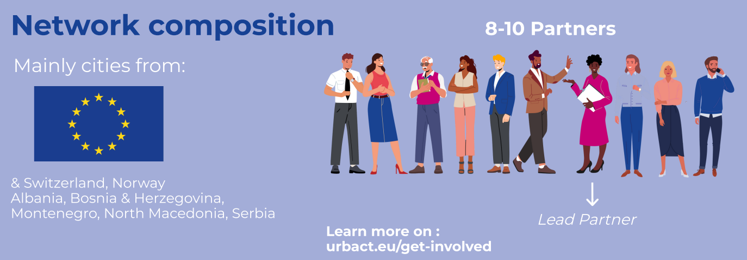
Notes:
Before accepting partners coming from IPA countries the LP candidates should consult with URBACT Secretariat to check the updates around legal framework (apn@urbact.eu)

Slide 19
Who is expected to participate ?
« CITIES » :
Cities, municipalities, towns
Local agencies defined as public or semi-public organisations set up by a city
Infra-municipal tiers of government such as city districts and boroughs
Metropolitan authorities and organised agglomerations
No limitations in terms of size and population
« NON - CITIES » :
Universities and research centres, Provincial/ Regional authorities, Managing Authorities (EU Cohesion and solidarity funds)
Institutions from:
27 EU Members States
Partner States (Switzerland and Norway)
IPA countries (Albania, Bosnia and Herzegovina, Montenegro, North Macedonia and Serbia)*
Other countries (but on own costs)
*5 IPA countries novelty – check carefully if the legal framework is fully set and in place in a particular IPA country

Slide 20
Partnership eligibility requirements
2 “non-city partners” allowed per network
A beneficiary can be a partner in max. 2 approved networks
A city can be a candidate Lead Partner of one Action Planning Network proposal only (but can be additionally a Project Partner in another network)
Only cities from the 27 EU MS can be Lead Partners under this call
A network must include partners from at least 7 different countries
Partners from non-EU countries not counted in this geographical coverage of EU region types
Notes:
The map showing the categorisation of EU Regions for 2021-2027 can be found here: https://ec.europa.eu/regional_policy/sources/graph/poster2021/eu27.png
The full list of regions eligible for funding from the ERDF and the ESF Plus and of Member States eligible for funding from the Cohesion Fund for the period 2021-2027 is available at this link here: https://eur-lex.europa.eu/legal-content/EN/TXT/?uri=CELEX%3A32021D1130

Slide 21

Find Partners!
Use the URBACT Partner Search Tool:
Submit your network idea
Look for partners
Find a network idea to join
+ You can reach out to your National URBACT Points
Notes:
NUPs should be mentioned as another key support in finding partners

Slide 22
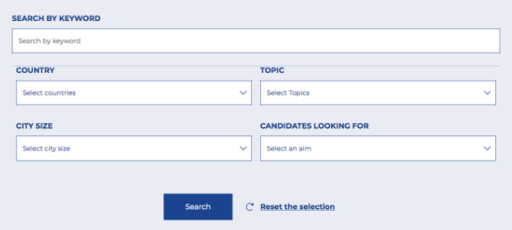


Find Partners!
urbact.eu/partnersearchtool

Slide 23
Financial resources for the network
Network budget: Up to EUR 850 000
(total incl. local co-financing)
+ Additional resources for expertise fees:
Up to 170 days of expertise = EUR 144 500
(payed by the programme directly)
Region type | Co-financing rate
Partners from EU « more developed regions » | Up to 65% by ERDF
Partners from EU « transition regions » | Up to 70% by ERDF
Partners from EU « less developed regions » | Up to 80% by ERDF

Slide 24



Action planning network journey 31 Months,10 Quarters, 4 Stages
2023
2024
2025
Q1 Jun Aug | Q2 - Sept Nov (+Dec) |  | Q3 - Jan Mar | Q4- Apr Jun | Q5 - Jul Sept | Q6 - Oct Dec | Q7 - Jan Mar | Q8 - Apr Jun | Q9 - Jul Sept | Q10 - Oct Dec
Activation |  |  | Planning Actions |  |  |  | Preparing Implementation |  |  | Finale
STAGES
Notes:
*NO/CH to contact national Ministry (KDD)/Federal Office (ARE) to receive information on the available funds under this call.
**For IPA countries: the conditions to participate have to be checked with the national authorities concerned.

Slide 25




Action planning network journey 31 Months,10 Quarters, 4 Stages
2023
2024
2025
Q1 Jun Aug | Q2 - Sept Nov (+Dec) |  | Q3 - Jan Mar | Q4- Apr Jun | Q5 - Jul Sept | Q6 - Oct Dec | Q7 - Jan Mar | Q8 - Apr Jun | Q9 - Jul Sept | Q10 - Oct Dec
Activation |  |  | Planning Actions |  |  |  | Preparing Implementation |  |  | Finale
STAGES
KEY NETWORK DELIVERABLES
Network Roadmap Baseline Study process
Six Quarterly Network Reports
Network
Results
Products
& Communication Plan
Network articles and optional Network Sharing products
Notes:
Activation : Further develop network proposals and methodology
planning actions : Update on network progress

Slide 26



Action planning network journey 31 Months,10 Quarters, 4 Stages
2023
2024
2025
Q1 Jun Aug | Q2 - Sept Nov (+Dec) |  | Q3 - Jan Mar | Q4- Apr Jun | Q5 - Jul Sept | Q6 - Oct Dec | Q7 - Jan Mar | Q8 - Apr Jun | Q9 - Jul Sept | Q10 - Oct Dec
Activation |  |  | Planning Actions |  |  |  | Preparing Implementation |  |  | Finale
STAGES
KEY NETWORK DELIVERABLES
Network Roadmap Baseline Study process
Six Quarterly Network Reports
Network
Results
Products
& Communication Plan
Network articles and optional Network Sharing products
Getting inspired by other cities across Europe with various exchange and learning activities
Ready for Action
Meeting
Focus on
Integrated
approach
IAP
peer
review
Final
NETWORK LEVEL
sharing events
Notes:
4 meetings amongst the 6 have pre-defined focus

Slide 27


Action planning network journey 31 Months,10 Quarters, 4 Stages
2023
2024
2025
Q1 Jun Aug | Q2 - Sept Nov (+Dec) |  | Q3 - Jan Mar | Q4- Apr Jun | Q5 - Jul Sept | Q6 - Oct Dec | Q7 - Jan Mar | Q8 - Apr Jun | Q9 - Jul Sept | Q10 - Oct Dec
Activation |  |  | Planning Actions |  |  |  | Preparing Implementation |  |  | Finale
STAGES
KEY NETWORK DELIVERABLES
Network Roadmap Baseline Study process
Six Quarterly Network Reports
Network
Results
Products
& Communication Plan
Network articles and optional Network Sharing products
Getting inspired by other cities across Europe with various exchange and learning activities
Ready for Action
Meeting
Focus on
Integrated
approach
IAP
peer
review
Final
NETWORK LEVEL
sharing events
Draft
plans
Final
Integrated Action Plan (IAP)
URBACT Local Group
Set up
LOCAL LEVEL
Strengthening your skills by experimenting participatory and integrated approaches
Notes:
*NO/CH to contact national Ministry (KDD)/Federal Office (ARE) to receive information on the available funds under this call.
**For IPA countries: the conditions to participate have to be checked with the national authorities concerned.

Slide 28









Action planning network journey 31 Months,10 Quarters, 4 Stages
2023
2024
2025
Q1 Jun Aug | Q2 - Sept Nov (+Dec) |  | Q3 - Jan Mar | Q4- Apr Jun | Q5 - Jul Sept | Q6 - Oct Dec | Q7 - Jan Mar | Q8 - Apr Jun | Q9 - Jul Sept | Q10 - Oct Dec
Activation |  |  | Planning Actions |  |  |  | Preparing Implementation |  |  | Finale
STAGES
KEY NETWORK DELIVERABLES
Network Roadmap Baseline Study process
Six Quarterly Network Reports
Network
Results
Products
& Communication Plan
Network articles and optional Network Sharing products
Getting inspired by other cities across Europe with various exchange and learning activities
Ready for Action
Meeting
Focus on
Integrated
approach
IAP
peer
review
Final
NETWORK LEVEL
sharing events
Draft
plans
Final
Integrated Action Plan (IAP)
URBACT Local Group
Set up
LOCAL LEVEL
Strengthening your skills by experimenting participatory and integrated approaches
Network experts
Digital
Gender
Green
PROGRAMME
SUPPORT
Incl. tools on financing
Capacity building activities, knowledge uptake and visibility activities, support with policy advocacy by national URBACT points
Notes:
*NO/CH to contact national Ministry (KDD)/Federal Office (ARE) to receive information on the available funds under this call.
**For IPA countries: the conditions to participate have to be checked with the national authorities concerned.

Slide 29
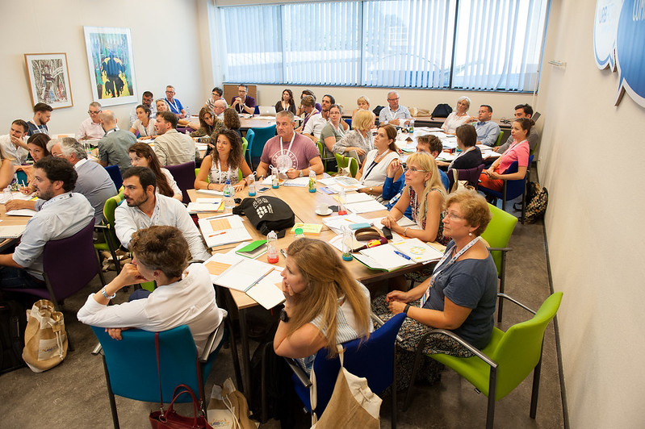
Where to start with the application?
Main documents:
Terms of Reference
Guide for applicants
Programme Manual
All available at:
urbact.eu/get-involved

Slide 30
Some Hints and Tips
Go carefully through the application form outline document and the eligibility & assessment criteria in the Terms of References
Check all the aspects for building a successful proposal set out in the Guide
Consult FAQ at urbact.eu/get-involved
Cannot find what you are looking for? Contact apn@urbact.eu
Notes:
Assessment criteria: importance of criteria, in particular quality and relevance of partnership + proposed methodology and activities

Slide 31
Submission procedure (Lead partners responsibility)
2 steps required to submit your application:
1 - Online submission of the application form through the SYNERGIE-CTE system i in English by 31 March 2023 at 15:00 CEST
      information on the SYNERGIE system outlined in the Guide to SYNERGIE (available soon on urbact.eu/get-involved)
  2 - Send the application package by email to APN@urbact.eu by
  3 April 2023 at 15:00 CEST
      including scan of the signed PDF of the application generated through SYNERGIE-CTE, signed letters of commitment and all additional requested documents

Slide 32
Assessment process
Assessment of Action Planning Network proposals will be carried out by the External Assessment Panel based on the assessment criteria
Formal approval by the Monitoring Committee: end of May 2023
Approved networks’ starting date: 1 June 2023

Slide 33
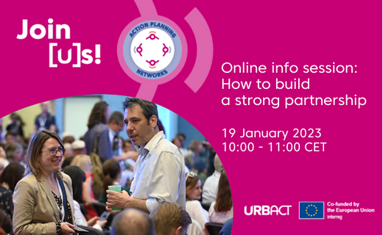
URBACT Secretariat’s online info sessions!
17 January, 10:00 – 11:00 CET,
19 January, 10:00 -11:00 CET, How to build a strong partnership for an Action Planning Network
7 February, 10:00 - 11:00 CET, Exchange and learning during the network journey
7 March, 10:00 - 11:00 CET, Time to submit your application - tech & troubleshooting
Details: urbact.eu/get-involved

